Slide 1
Molecular Simulation Toolkit
https://github.com/zhteg4pvt/nemd/
Main Contributor: Teng Zhang
Email: zhteg4@gmail.com
Notes:
Thank you so much for the invitation and the most pleasant journey in my life at Notre Dame.
I really enjoy my PHD research, and wrote a few scripts after that in a company.
In the past 2 years, I have been working on this small project to lower the development barrier.
Wish to share a different angle and hopefully a bit value.
The software view feels like reading manual and attending workshop. Please bear with me.

Slide 2
BSD 3-Clause License
Allow redistribution in any forms, with or without modification.
In short:
The general BSD 3-Clause copyright allows similar redistribution.
The software is provided as is and in no event shall the copyright holder or contributors be liable for any damages.
Neither the name of the copyright holder nor the names of its contributors may be used to endorse or promote products derived from this software without specific prior written permission.
Full Information in https://github.com/zhteg4pvt/nemd/tree/main/LICENSE
Notes:
We use BSD license, which allows similar redistribution.
Copyright holder and contributors are not liable for any damages.
Written permission is requested when endorsing derived products.
In other words, responsibility and rewards come in pairs.

Slide 3
Installation
# Install Packages case $OSTYPE in darwin*) brew install gh git vim python@3.10 ;; linux*) sudo apt-get install -y gh git python3-pip ;; esac
# Clone code
gh auth login --hostname GitHub.com --web gh auth setup-git gh repo clone zhteg4pvt/nemd ~/git/nemd # Install drivers (lspci | grep VGA | grep -q -v NVIDIA) && exit 0 sudo ubuntu-drivers --gpgpu install sudo apt upgrade -y read -p "Driver installed. Reboot? [y/n]? " answer case "$answer" in Y|y) echo "rebooting..."; reboot ;; *) ;; esac echo "no reboot. (GPU driver may not be working)"
sh/setup
1)* bash -c "$(curl 'https://raw.githubusercontent.com/zhteg4pvt/nemd/main/setup')"
2) cd ~/git/nemd; pip3.10 install . -v
class Distribution:
def run(self):
# Install packages self.prereq()
# Compile binaries self.compile()
# Distribute shell, python, and data self.setup()
def prereq(self): subprocess.run('brew install –q gcc', shell=True)
def compile(self): subprocess.run('bash install.sh', shell=True)
def setup(self):
setuptools.setup(
packages=[nemd, alamode], package_dir=[module/nemd], package_data={lammps: [build/lmp]}, scripts= =[sh/nemd_run])
setup.py
Name | OS | CPU | Graphic | Memory (GB) | setup (min) | pip (min) | test (min)
Mac Mini | Tahoe 26.0 | Apple M4 | Apple M4 | 16 | 4.15 | 4.95 | 0.85
MXZ | Ubuntu 22.04.5 LTS | Intel® Core™ i5-11400F | GeForce RTX 3060Ti | 16 | 5.63 | 10.64 | 1.10
MacBook Pro | Sequoia 15.7 | Intel Core i5 | Intel Iris Plus 645 | 16 | 8.01 | 10.55 | 2.05
On brand new machine
Ubuntu: bash <(wget -qO- https://raw.githubusercontent.com/zhteg4pvt/nemd/main/setup)
Notes:
Installation is very simple and fast: 2 clicks within 10 min.
The shell script installs packages like python, downloads the source code, and installs GPU drivers.
Pip installs prerequisites, compiles binaries, and distributes data.
It takes 4 min to set up a brand new 500-dollar machine.
It takes another 5 min to install our package and 1 more minute on testing.

Slide 4
NEMD
Name | Description
sh | POSIX shell scripts
setup.py | PyPI installation on Darwin and Linux
module | External codebases, shared classes and functions
driver | Command line execution
workflow | Serialization and parallelization
premake | Environmental configuration
test | Unit, integration, scientific, and performance
practice | Trial and error learning curve
doc | Roadmap, summary, and documentation
Notes:
This is the top-level repository.
Besides the standard POSIX shell scripts, external codebases are also included as submodules.
The python drivers can be executed from command line, or automated as workflows.
premake sets the environment in which source code instead of installation is used.
Four types of tests are included: unit, integration, scientific, and performance.
Practice folder is for trial and error learning curve.
Doc directory contains roadmap and summary.

Slide 5
Architecture
Initiation
module/nemd
Job & Log
System, Constant, Wrapper
Constant On Disk
Application Focused
Molecular Dynamics Log
Force Field
Structure
Molecular Dynamics Trajectory
Conformer Search
Lattice Dynamics
Polymer
Jobcontrol
Builder, Molecular Dynamics Simulation, MD Post Analysis, and Solid Physics
driver
Decentralized Automation
workflow
Notes:
The code architecture consists of four layers.
The first layer includes system, constant, job, and log.
The application focused layer holds force field, structure, conformer, polymer, post analysis, lattice dynamics, and jobcontrol.
Command-line scripts form the third layer, and the decentralized automation makes the fourth layer.

Slide 6
Architecture
module/nemd
initiation
debug, lazy_import (__init__ )
job & log
system, constant, wrapper
constant on disk
job registration (jobutils)
file logger (logutils)
builtins (builtinsutils)
system (osutils)
process (psutils)
time (timeutils)
environment (envutils)
constants (constants)
hardcoded (symbols)
numba (numbautils)
numpy (numpyutils)
rdkit (rdkitutils)
points (geometry)
matplotlib (plotutils)
periodic table (table)
Stillinger-Weber (sw)
lammps func (lmpfunc)
application focused modules
seeds in light blue
indicates dependence
(linear, branching, and merging)
centers and terminators in purple
dynamic force field (sw)
in script (lmpin)
lammps log (lmplog)
conformer, molecule, structure
(structure)
periodic boundary (pbc)
atomic data (lmpatomic)
trajectory (traj)
trajectory frame (frame)
opls data (lmpfull)
type & assign
(oplsua)
lattice dynamics (alamode)
crystal (xtal)
parser (parserutils)
visualization (molview)
distance (dist)
conformer search (structutils)
executable (process)
job, aggregator, task (taskbase)
log & traj (analyzer)
polymer (polymutils)
repeat unit (cru)
runner (jobcontrol)
driver & test tasks (task)
testing (test)
check (check)
driver
Builder : molecule (mol_bldr), amorphous (amorp_bldr), crystal (xtal_bldr) Molecular Dynamics: LAMMPS runner (lammps)
Solid Physics: reciprocal space (recip_sp), phonon dispersion (dispersion) MD Post Analysis : log (lmp_log), trajectory (lmp_traj)
amorphous builder → molecular dynamics → trajectory analysis (ab_lmp_traj) crystal builder → molecular dynamics → log analysis (cb_lmp_log)
molecule builder → molecular dynamics → log analysis (mb_lmp_log) run command → check results → update tags (test)
workflow
Notes:
Here each name is a python file, and I know it’s overwhelming. Just a few examples.
Subclasses of builtins like list and dictionary belong to the first layer, sitting together with table, logger, and plotter.
In addition, the dependence tree helps us to avoid cyclic importing.
For example, atomic data imports conformer, molecule, structure, periodic boundary, dynamic force field, and simulation protocol.
Typer and assignment expand the force field to include OPLS-UA.
Merging with distance cell, the coordinates further eliminate clashes.
Finally, long chains are easily built with the help of repeat unit.

Slide 7
Testing
Integration
Performance
Scientific
unit
Type | Command | Location | Goal | Description
Unit | nemd_test | test/unit/ | Bug free when parameterizing code pieces | Functions and methods are operating as expected.
Integration | nemd_itest | test/integration/ | expected behavior when combining pieces | Scripts run without tracebacks and yield reproducible results.
Performance | nemd_ptest | test/performance/ | resource efficiency on scaling up | Bottleneck identification and nullification for speed, responsiveness and stability.
Scientific | nemd_stest | test/scientific/ | correctness, accuracy, and repeatability | Physical meaning and standard deviation
* source premake allows the nemd_*test to run in any directory
Notes:
Features are developed step by step across so many files.
We need tests to make sure that new addition won’t break the previous behavior.
Unit tests ensure bug free by parameterizing functions and methods.
Integration tests guarantee behavior when scripts combine pieces.
Performance tests care about the resource efficiency when scaling up.
Scientific tests focus on physical meaning and reproducibility.

Slide 8
Unit Testing
nemd_cover | run analysis, create html, open browser
nemd_cover driver | analyze all driver tests
nemd_cover module cru_test.py | analyze cru_test.py only
nemd_test | all tests in parallel
nemd_test [file1 file2...] | specific tests
nemd_test -m slow [file1 file2...] | selected tests marked with slow
Command | PYTEST | Dirname | Type | Results
nemd_cover | "-m ''" | workflow | statements missing excluded coverage | 199 0 8 100%
 |  | driver | statements missing excluded coverage | 462 0 16 100%
 |  | module | statements missing excluded coverage | 6241 0 164 100%
Command | PYTEST_ADDOPTS | Type | Result (num|sec) | Avg (sec)
nemd_test | "-m 'not slow'" | module driver workflow | 1763 | 15.30 129 | 6.54 43 | 4.24 | 0.0135
 | "-m slow" | module driver workflow | 1 | 20.19 1 | 3.95 no tests | 13.49
* source premake before running tests
Excluded: __main__, numba, platform-incompatible
Notes:
To make sure of the quality, each method can be run and tested independently.
nemd_test without arguments runs all unittests in parallel.
It also runs specific tests filtered by markers.
We have almost 2 K unittests for module, more than one hundred for driver, and 43 for workflow.
On average, each unitest takes only 0.01 second.
Unittests that last more than 3s are marked as slow and disabled by default.
2 K unitests sound a lot, but are they sufficient?
nemd_cover runs the coverage analysis and creates html report
We achieved 100% coverage for module, driver, and workflow.
In general, passing all previous unittests means no break of protected behavior.

Slide 9
test_workflow.py
Supported arguments | Description
-name {integration,performance,scientific} | reproducibility: nemd_itest resource efficiency: nemd_ptest physical meaning: nemd_stest
ID | Select the tests by ids
-dirname DIRNAME | Search test(s) under this directory
-label LABEL [LABEL ...] | Select tests marked with the given names
-slow SECOND | Skip (sub)jobs slower than this criteria
-task {cmd,check,tag} | cmd: run the commands in the cmd file check: check & collect the results tag: update the tag file (e.g., time, name)
-jtype {task,aggregator} | task: run tasks and register outputs aggregator: collect results
-CPU INT [INT ...] | Total number of CPUs [the CPUs for one task (1 by default)]
-screen {off,serial,parallel,job} | Print the serialization, parallelization, and job details
-DEBUG [{True,False}] | Enable or disable (sub)job debug mode
-copy | Copy original test data into the working directory
Notes:
test_workflow.py runs script-level tests by id, name, and duration.
The cmd, check, and tag processes run either together or separately.
Subjob cmd sets the debug mode, and the workflow can take over the control.

Slide 10
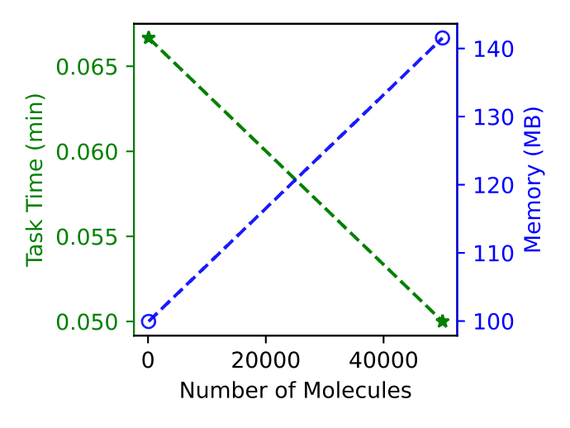
Integration Test
file
cmd | Run drivers and workflows (shell command)
param | Parametrize one command into multiples (shell syntax)
tag | Select test by name and time (shell syntax)
check | Check the results against expectations (shell command)
Param Format
comment | The str after # names the parameter
parameter | Replace the $param in cmd to generate command(s)
Tag Key
label | The script name (-NAME in the .log)
slow | The time cost on execution
cd test/integration/0049; head cmd param check tag
==> cmd <==
# Performance: [Ar] Amorphous Builder
nemd_run amorp_bldr_driver.py [Ar] -method grid -mol_num $param -seed 1
==> param <==
# Number of Molecules
100
50000
==> tag <==
label number_of_molecules
slow 100.0 00:00:04 50000.0 00:00:05
==> check <==
nemd_check collect task_time memory
nemd_check exist collect.csv collect.svg
Check Command
general shell cmd | echo, [ -f file ], &&, ||, ( grep pattern file ), etc.
nemd_check exist | File existence
nemd_check glob | Match number from pattern expansion
nemd_check has | Specific strings in file
nemd_check cmp | Content comparison
nemd_check collect | Collect information from log files
Notes:
Integration tests cover the script-level behaviors and protect mainstream features.
The cmd file executes the main command, which may be parametrized into multiples.
The tag records the status, and the check handles the outputs.
We use test 49 as one example.
The cmd runs amorphous builder, and the molecule number is parameterized with 100 and 5000.
Tag documents the name and duration.
Check collects task time and memory usage.
Besides the general shell commands, we also support match count, content comparation, and log collection.
In general, behaviors not protected by integration tests are not main features.

Slide 11
Builder
amorp_bldr_driver.py builds polymers from constitutional repeat units, and packs molecules into an amorphous cell.
CRU: initiator, monomer, terminator, and regular molecule
-method grid: grid the space and put molecules into sub-cells
-method pack: randomly rotate and translate molecules
-method grow: grow molecules from the smallest rigid fragments
mol_bldr_driver.py builds single polymer or molecule via the grid method.
-substruct SMILES (VALUE): set or measure the substructure geometry
xtal_bldr_driver.py generates crystal supercell with scaled lattice vectors.
-name Si: diamond cubic structure (space group 227)
-dimension: duplicate to generate the supercell
Stillinger-Weber potential
Test ID | method/driver | Molecule/Polymer | Structure | Comment
1 | grid | 1 | CC(C)O | Single
2 | mol_bldr | 2(2) | CCCC (120) | Set Geom
3 | mol_bldr | 1(3) | CCC | Measure
4 |  | 1 | 10 | CCCCCC(C)O [Ar] | Mol | Mol
5 | Pack | 1 | CC(=O)O | Single
6 |  | 11(6) | *CC* | Polym
7 |  | 11(6) | *CC* | Reduced Density
8 | Grow | 10 | C | Mol
9 |  | 1 | 1 | O CCCO | Mol | Mol
10 |  | 3(5) | *CC(O)* | Polym
11 |  | 5(3) | 15 | *CC(*)C(=O)O CN(C)C=O | Polym | Mol
12 |  | 5(5) | *CC* | Relocation
13 |  | 10 | 10 | [Ar] CCCC | Failed Initialization
14 |  | 1(200) | *CC* | Single Long
15 |  | 10(100) | *CC(*)C(=O)O | Multi Long
16 |  | 1 | O | TIP3P
17 |  | 1 | O | SPCE
18 |  | 1 | O | SPC
19 |  | 1 | CO
20 |  | 1 | CCO
21 |  | 1 | CC(=O)C
22 |  | 1 | CCC(=O)CC
23 |  | 1 | CC(C)(C)C
24 |  | 1 | CC(C)CC(=O)C(C)(C)C
25 |  | 1 | 1 | O CCCO
26 |  | 10 | [Li+].[F-]
27 |  | 10 | [Na+].[Cl-]
28 |  | 5 | [Br-].[Mg+2].[Br-]
29 |  | 10 | [K+].[Br-]
30 |  | 5 | 5 | [Rb+].[Cl-] [Cs+].[Br-]
31 |  | 5 | 5 | 5 | 5 | 5 | [He] [Ne] [Ar] [Kr] [Xe]
32 |  | 1 | 1| 1| 6 | [Ca+2] [Sr+2] [Ba+2] [Cl-]
Test ID | method/driver | Molecule/Polymer | Structure | Comment
33 | xtal_bldr | 1x2x3 supercell | Si (face centered-cubic) | Scale Factor 0.95
52 |  | 1 | "C*.*CC*.C*" | inr, mono, ter
53 |  | 1 | "[*:1]C([*:1])([*:1]).*C*" | inr with multiple stars
54 |  | 1 | "*C" | terminator only
55 |  | 1 | "[*:1]C([*:1])[*:1]" | initiator only
56 |  | 1 | "[*:1]C([*:1])[*:1].C*" | initiator, terminator
57 |  | 1 | 0 | No Relaxation
49 |  | 1 | [Ar] | Performance (mol num)
58 |  | 1 | [Ar] | Performance (Press)
amorp_bldr_driver.py as driver unless noted otherwise
composition separated by |, repeat unit number inside (), polymerization capping as *
Notes:
We have three builders covered by 41 integration tests.
For example, build polymers from initiator, monomer, and terminator.
Mix polymers and regular molecules into one amorphous cell by spatial grids, random translation, or conformer search.
Water model, density reduction, initiator relocation, and simulation without relaxation are also covered.
In addition, molecule builder sets or measures substructure geometry.
Crystal builder creates supercell with scaled lattice constant.

Slide 12
Decentralized Automation
ab_lmp_traj_workflow.py builds amorphous structure from different seeds, runs simulation, and analyzes the trajectory.
mb_lmp_log_workflow.py builds molecules with different geometries, calculates single point energy, and analyzes the log file.
cb_lmp_log_workflow.py builds crystal structure with scaled lattice vectors, runs simulations, and analyzes the log file
Molecular Dynamics
lammps_driver.py runs molecular dynamics simulations.
GPU auto-detection on Linux.
-CPU NUM: multiple CPU threads via OPENMP on Linux.
lmp_log_driver.py analyzes molecular dynamics log file.
-task: temperature, pairwise energy, molecular energy, total energy, pressure, volume
lmp_traj_driver.py analyzes molecular dynamics trajectory.
-task: structural density, radial distribution function, mean squared displacement & diffusion coefficient, clashes between atoms, coordinates visualization, xyz file writer
-PYTHON: native python (0), compiled Numba (1), cached Numba (2)
Solid Physics
recip_sp_driver.py plots direct and reciprocal lattice of Hexagon (graphene).
-miller_indices: Miller Indices defines the plane
dispersion_driver.py calculates and plots phonon dispersion.
-name: Name to retrieve the crystal structure from the database
Test ID | Driver/Workflow | Comment
34 | lammps | Molecular Dynamics: Single Point Energy
35 | lammps & lmp_log | Molecular Dynamics (OpenMP on Ubuntu) → Log Analyzer
36 | lmp_log | Thermodynamic Data Analysis
37 | lmp_traj | RDF, Density, Clash, XYZ, MSD and visualization
51 |  | No datafile
38 |  | All-pair RDF
39 |  | RDF within cutoff | Original | Python
40 |  |  | Compiled | Numba
41 |  |  | Cached
42 |  |  | Uncompiled
43 | recip_sp | Real Space Plane Norm = 2π / Reciprocal Vector Summation
44 | dispersion | Primitive Cell, Symmetry, Force Constant, K-Path, and Phonon
45 | ab_lmp_traj | Ar Gas, Berendsen NPT (GPU on Ubuntu), Density → Merge
50 |  | Single atom and single frame
46 | mb_lmp_log | The energy hypersurface
47 |  | Geometry measurement
48 | cb_lmp_log | Energy vs Scale Factor
Notes:
lammps_driver runs molecular dynamics with GPU auto-detection and multiple CPU threads.
lmp_log_driver analyzes the thermodynamic output like temperature, energy, pressure, and volume.
lmp_traj_driver provides density, radial distribution function, mean squared displacement, diffusion coefficient, clashes, visualization, and xyz.
Multi-cmd serial job, compilation state, with/without datafile, single frame, and single atom are also covered.
Reciprocal space plots real and reciprocal lattice of graphene.
Dispersion retrieves the crystal structure from database, and calculates phonon dispersion.
In addition, decentralized workflows serialize and parallelize driver jobs.
Test 50 builds argon gas from different random seeds, runs Berendsen NPT, and analyzes densities.
Test 46 builds butane conformers, calculates the single point energy, and plots the energy hypersurface.
Test 48 builds crystal supercell, scales the lattice constant, and plots the energy vs scale factor.

Slide 13
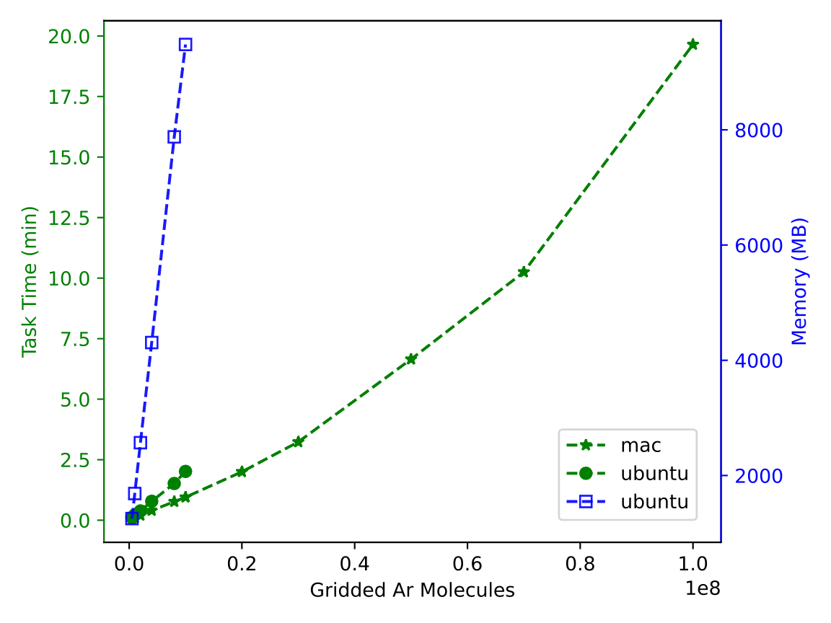
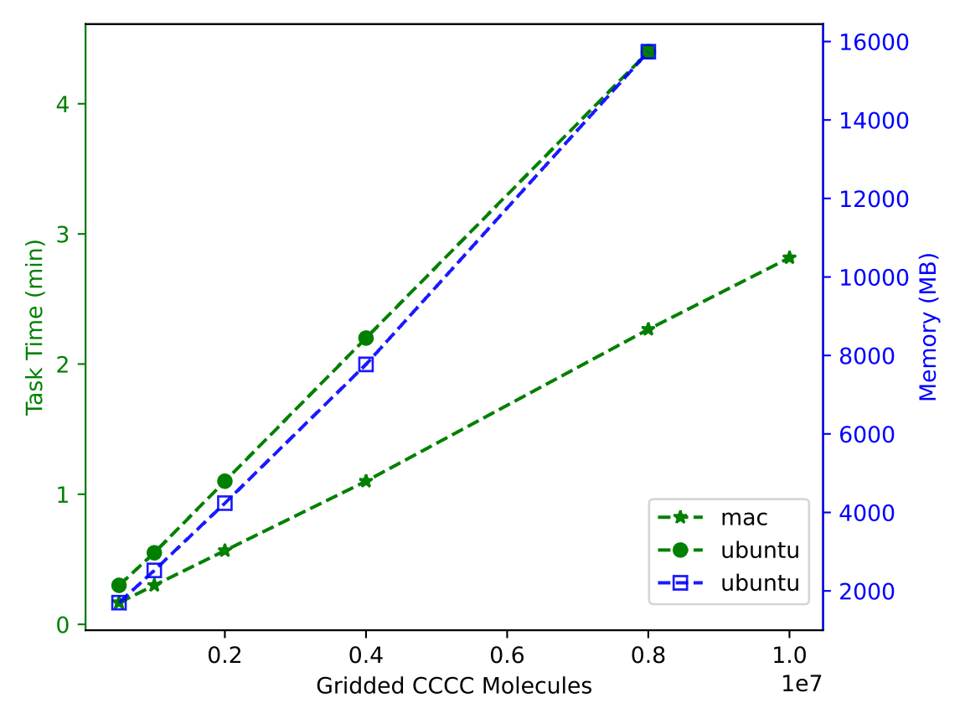
Performance Test
macOS Sequoia 15.6.1, Apple M4, 16GB LPDDR5
Ubuntu 22.04.5 LTS, i5-11400F, RTX 3060 Ti, 16GB
01: Gridded Amorphous Argon
02: Gridded Amorphous Butane
20 min: 100 million Ar
2.82 min
10 million butane
Notes:
With all major features protected, how about the performance? Especially at extreme condition.
As the molecule number becomes larger, the time and memory cost increases.
Within 20 min, we can grid an amorphous cell with 100 million argon atoms.
3 min is good for 10 million butane molecules.

Slide 14
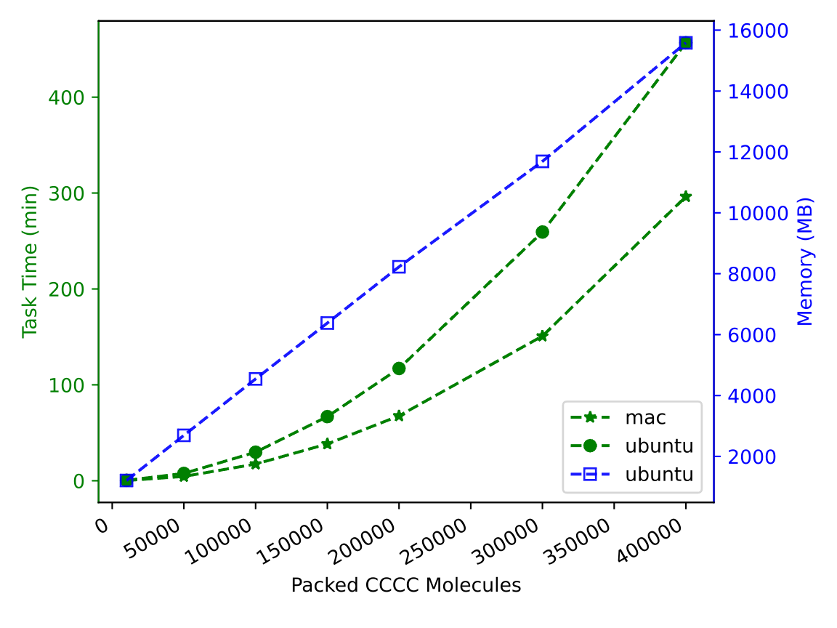
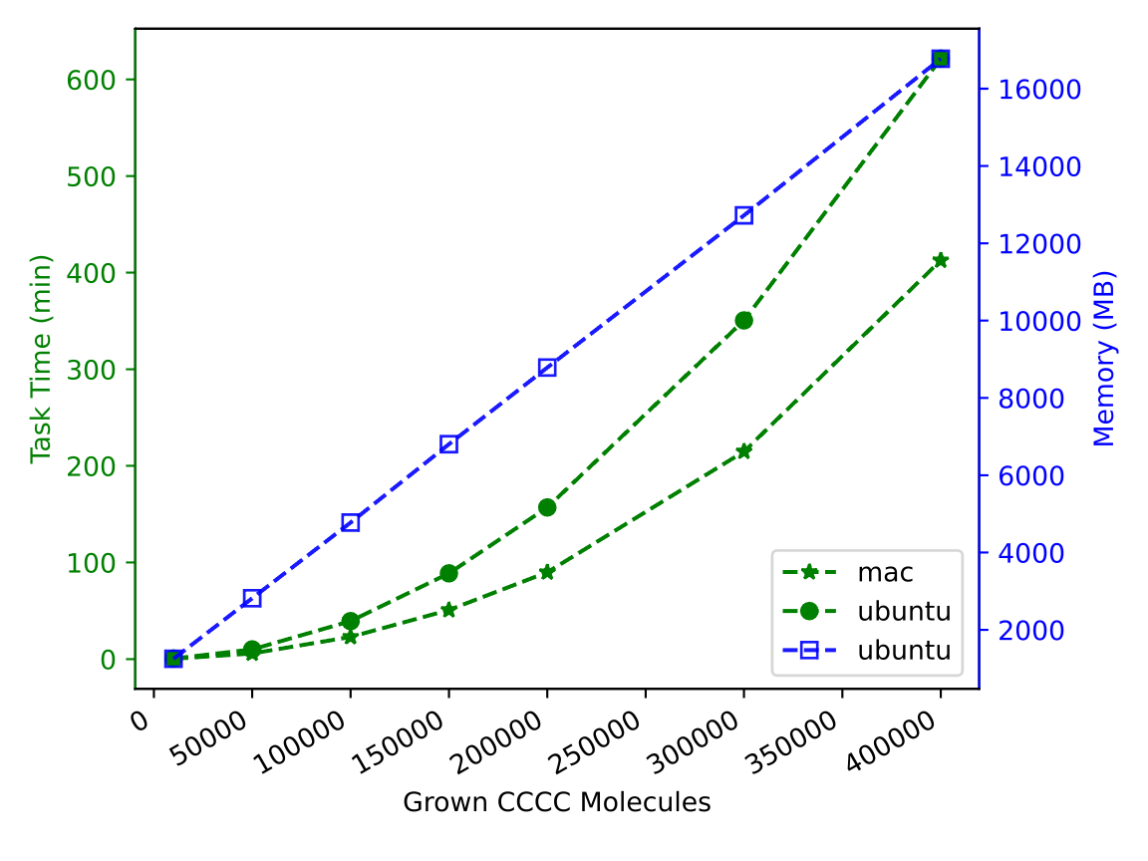
Performance Test
macOS Sequoia 15.6.1, Apple M4, 16GB LPDDR5
Ubuntu 22.04.5 LTS, i5-11400F, RTX 3060 Ti, 16GB
03: Packed Amorphous Butane
04: Grown Amorphous Butane
4.94 h: 0.4 million CCCC
6.88 h: 0.4 million CCCC
0.5 g/cm³ & 0.5 radius
Notes:
Random rotation and translation take 5 hours for 0.4 million butane molecules at a density of 0.5.
Conformer search increases the time cost by another 2 hours.

Slide 15
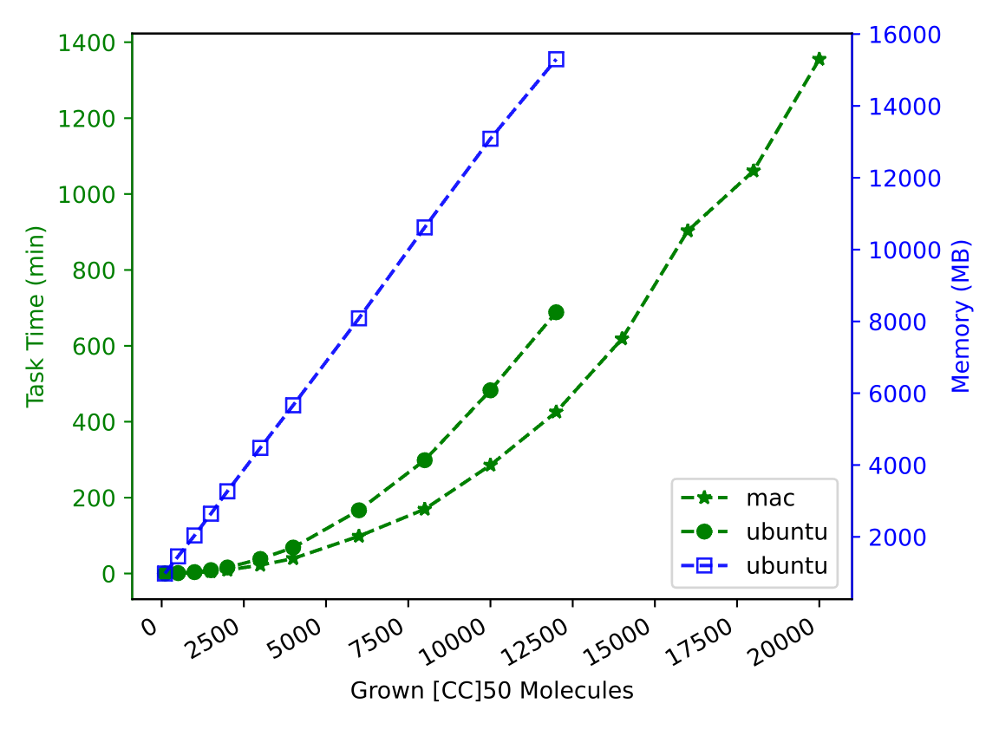
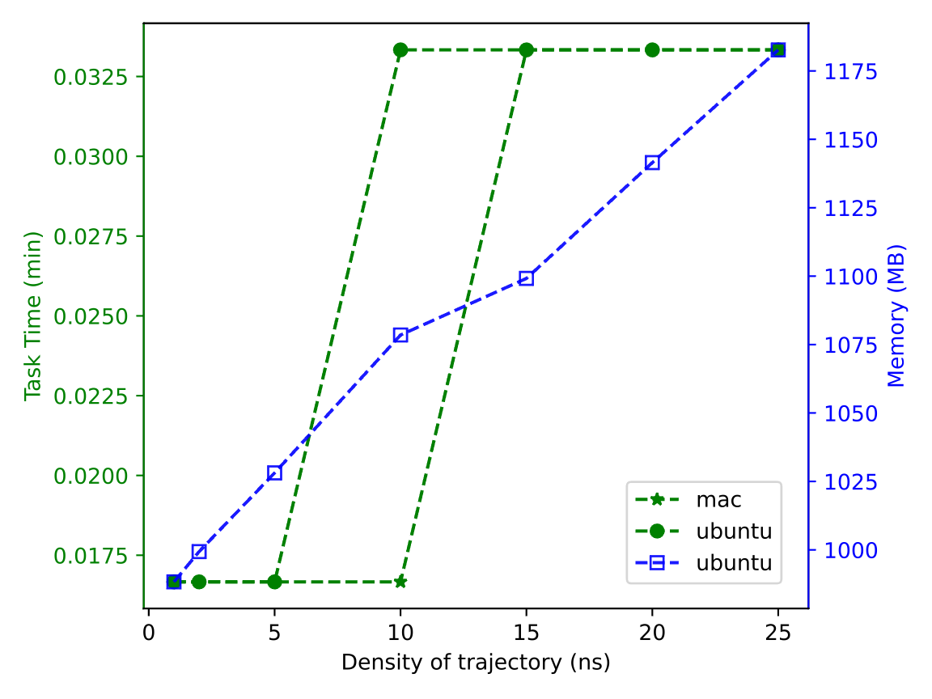
Performance Test
macOS Sequoia 15.6.1, Apple M4, 16GB LPDDR5
Ubuntu 22.04.5 LTS, i5-11400F, RTX 3060 Ti, 16GB
05: Grown Amorphous Polyethylene
06: Trajectory Density
22.59 h
20,000 (−CH₂−)₁₀₀
2 s / 200 MB
25,000 frames
0.5 g/cm³ & 0.5 radius
100 hexane per frame
Notes:
It takes 23 hours to grow 20 K polyethylene chains through bond rotation.
Here each polymer consists of 100-carbon atoms.
Trajectory analysis scales with frame number.
One frame of 100 hexane molecules is recorded every picosecond.
It takes only 2s and 200 MB memory to compute the density of 25 K frames.
Reading the trajectory is extremely fast and efficient.

Slide 16
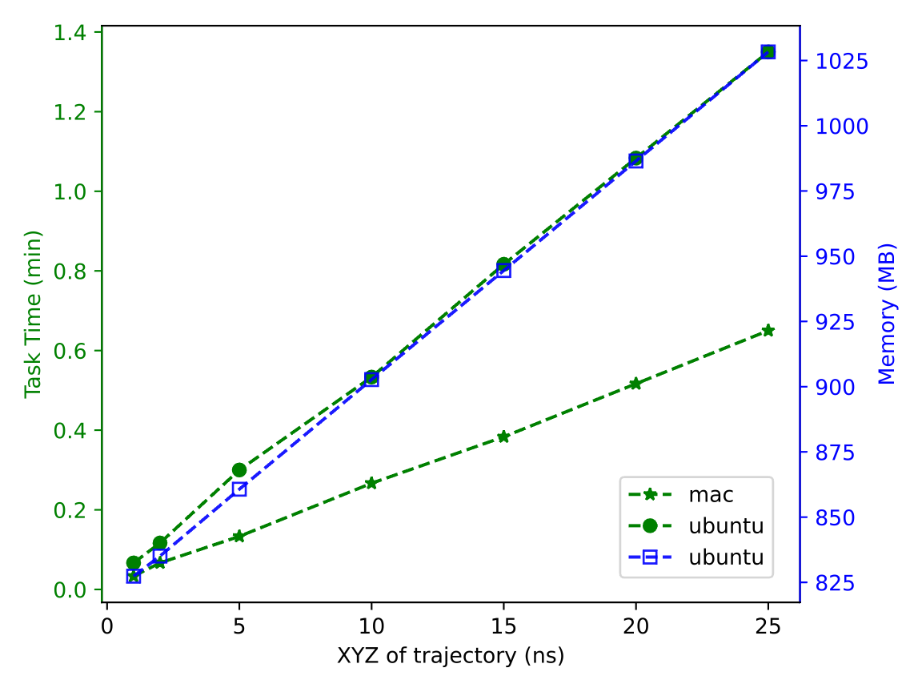
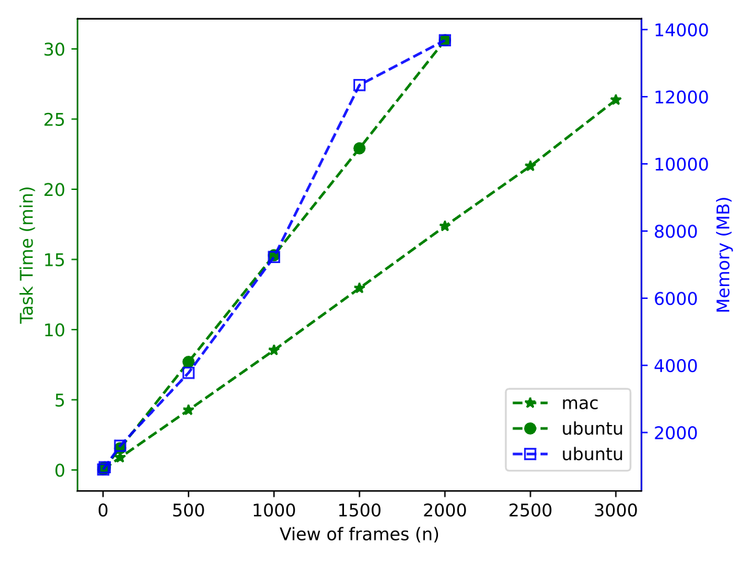
Performance Test
macOS Sequoia 15.6.1, Apple M4, 16GB LPDDR5
Ubuntu 22.04.5 LTS, i5-11400F, RTX 3060 Ti, 16GB
07: Trajectory XYZ writer
08: Trajectory HTML View
26.37 min
3,000 frames
0.65 min / 200 MB
25,000 frames
100 hexane per frame
Notes:
XYZ takes 40 seconds as the center of each molecule is wrapped into the PBC.
The visualization of 3 K frames takes 26 min as CPK coloring scheme is a bit expensive.

Slide 17
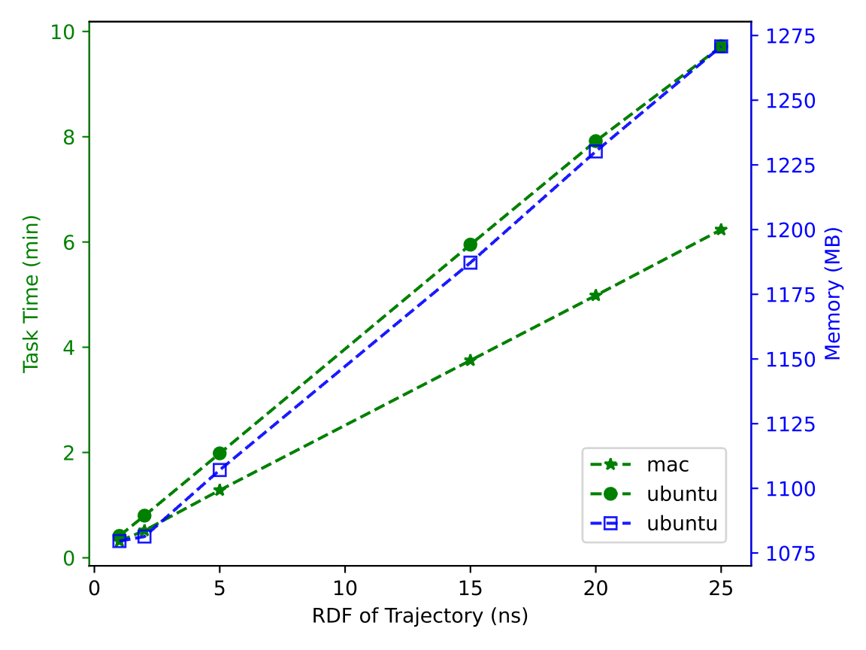
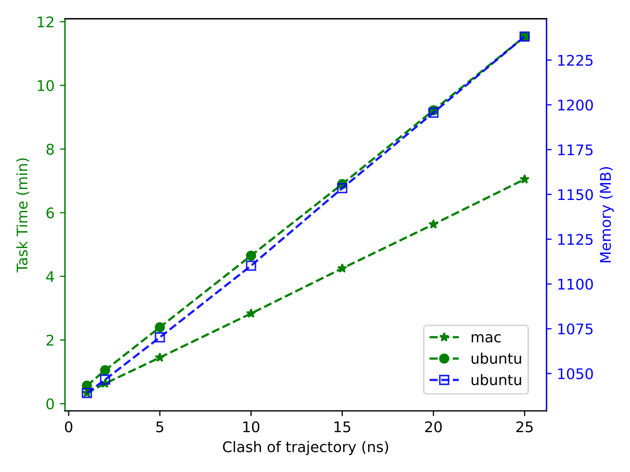
Performance Test
macOS Sequoia 15.6.1, Apple M4, 16GB LPDDR5
Ubuntu 22.04.5 LTS, i5-11400F, RTX 3060 Ti, 16GB
09: Trajectory Radial Distribution Function
10: Trajectory clash count
6.23 min / 191 MB
25,000 frames
7.05 min / 190 MB
25,000 frames
100 hexane per frame
Notes:
Radial distribution function of 25 K frames takes 6 min with the help of numba.
Similarly, clash count takes 7 min and 200 MB memory.

Slide 18
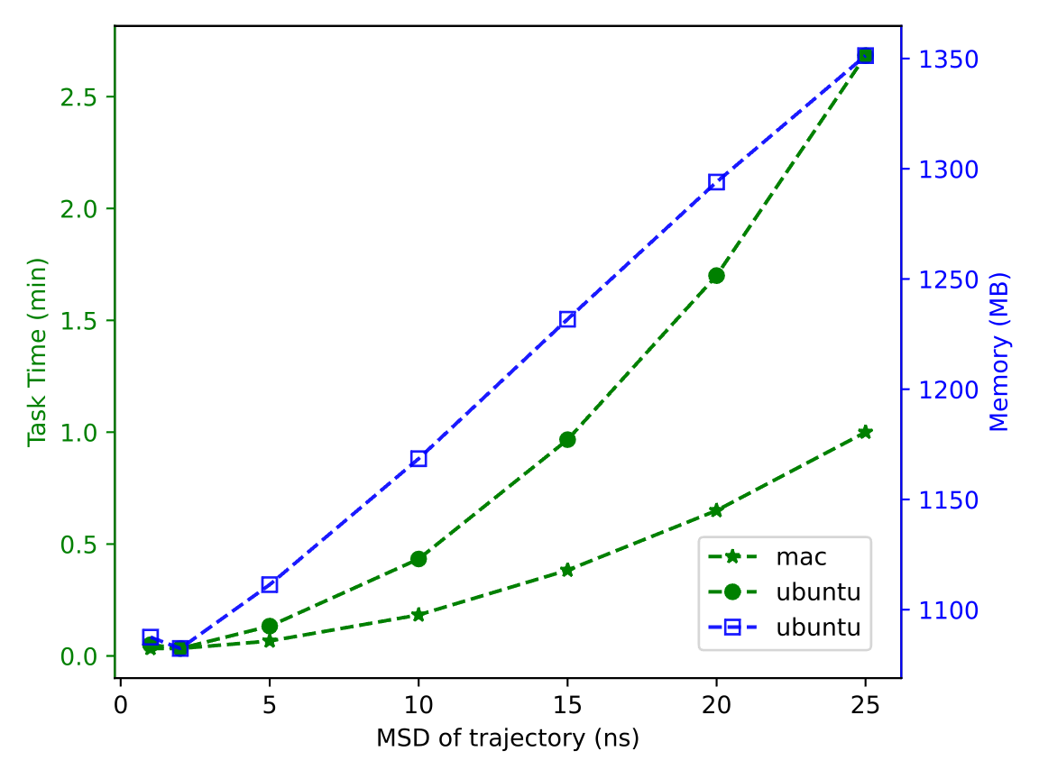
Performance Test
macOS Sequoia 15.6.1, Apple M4, 16GB LPDDR5
Ubuntu 22.04.5 LTS, i5-11400F, RTX 3060 Ti, 16GB
11: Trajectory Mean Squared Displacement
Name | Number | Duration
 |  | macOS | Ubuntu
Unit | 1937 | 00:00:41 | 00:00:44
Integration | 58 | 00:00:51 | 00:01:06
Performance | 11 | 44:31:48 | 69:21:38
Scientific | 20 | 11:28:46 | 10:47:26
2.68 min / 264 MB
25,000 frames
Unit:
All selected by PYTEST_ADDOPTS="-m ''"
Performance:
Simultaneous Job: 1
Params Threshold: 3E7 (01), 14E3(05), 3E3 (08)
Ubuntu Failed Param: 2E7 (01), 1E7 (02), 12E3 (05), 25E2 (08)
Scientific:
Simultaneous Job: 5
CPU Per Job: 2
100 hexane per frame
Notes:
Mean Squared Displacement is even faster: 3 min for 25 K frames.
In total, 11 performance tests take 45 hours when running in serial due to the physical memory limit.
In comparison, unit and integration tests take only 1 min when running in parallel.
Scientific tests take us 10 hours.
All the data and figures are automatically generated by tests.
That is to say, three clicks on a 500-dollar machine give you everything in this power point in 3 days.

Slide 19
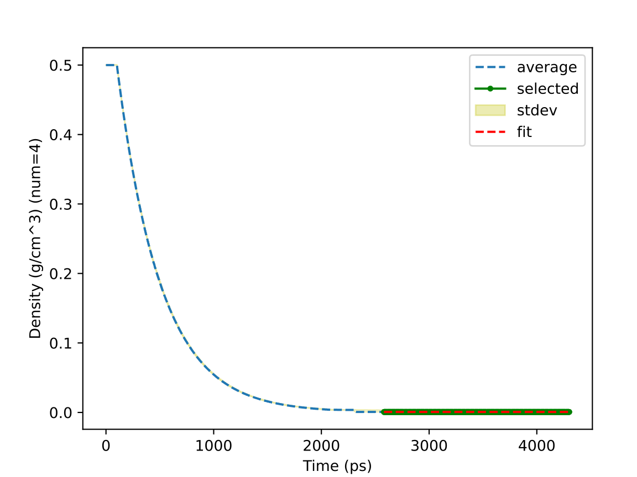
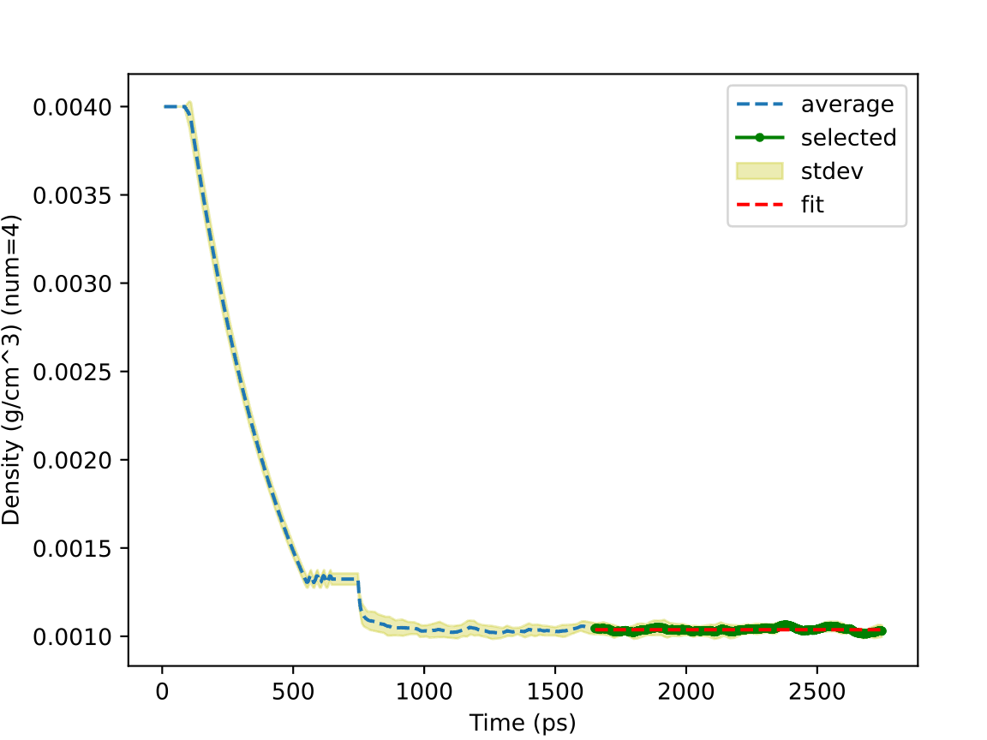
Scientific Test
https://en.wikipedia.org/wiki/Methane
https://www.engineeringtoolbox.com/ethane-C2H6-density-specific-weight-temperature-pressure-d_2088.html
01: Methane Gas Density
02: Ethane Gas Density
0.660 vs 0.657 kg/m³
(25 °C, 1 atm from ref)
1.038 vs 1.214 kg/m³
(300K, 1 bara from ref)
4 independent runs using different random seeds:
a) Amorphous builder at a density of 0.5 g/cm³ or 0.004 g/cm³
b) Molecular dynamics (Berendsen at 300 K and 1 atm)
c) Density analysis of trajectory frames
Notes:
For scientific test, we start from the simplest and most basic scenario: density prediction.
Methane atoms are packed at a density of 0.5 using different random seeds.
Berendsen NPT ensemble relaxes the system to reach the equilibrium.
The densities of 4 independent runs are analyzed and merged.
The prediction matches the experimental results perfectly even if the initial guess is way off.
However, the Ethane gas density is underestimated.

Slide 20
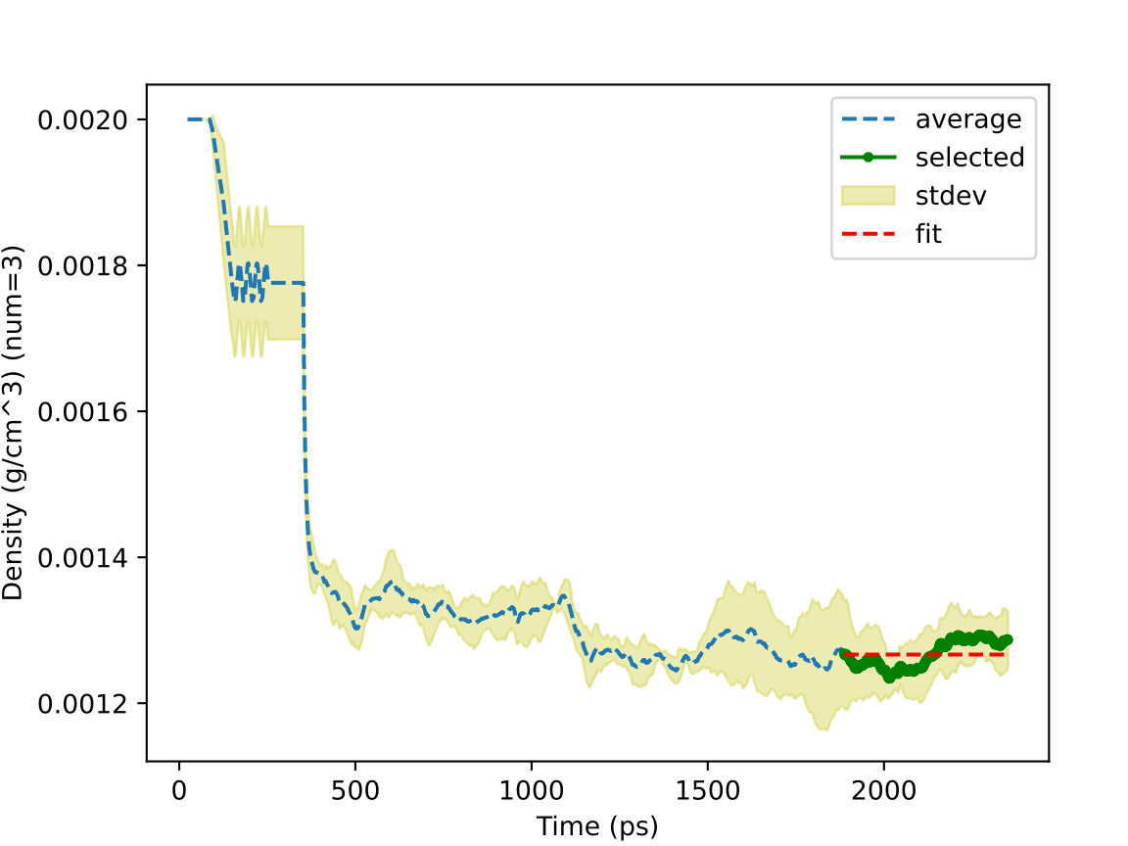
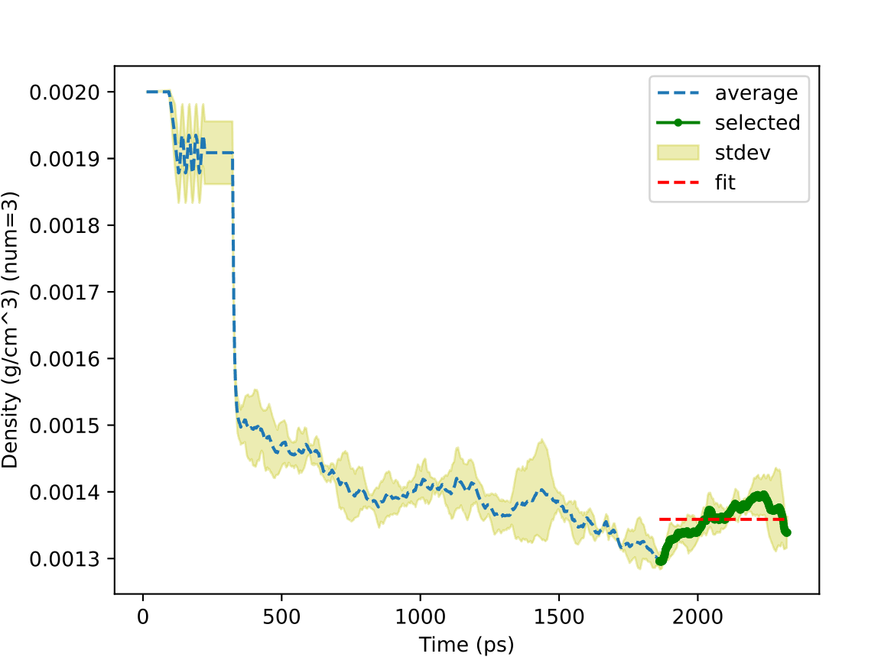
Scientific Test
https://en.wikipedia.org/wiki/Propane
https://www.engineeringtoolbox.com/butane-density-specific-weight-temperature-pressure-d_2080.html
03: Propane Gas Density
04: Butane Gas Density
1.267 vs 1.808 kg/m³
(0 °C, 101.3 kPa from ref)
1.359 vs 2.400 kg/m³
(300K, 1 bara from ref)
Amorphous builder (0.002 g/cm³) → Molecular Dynamics (Berendsen at 300 K and 1 atm) → Density Analysis
Notes:
As molecules become longer from propane to butane, the gas phase density prediction deviates even more compared to experiments.

Slide 21
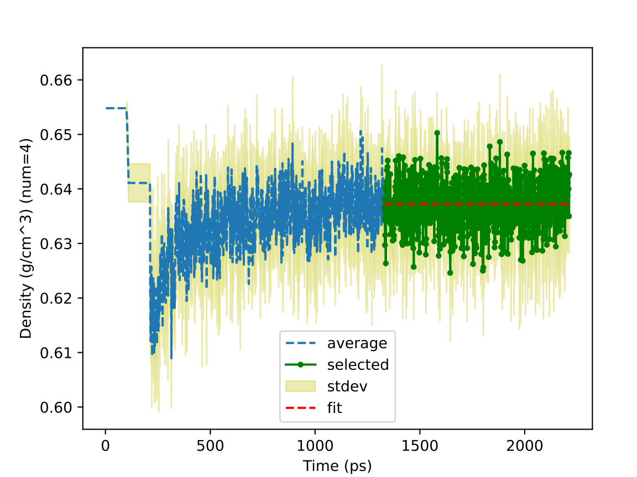
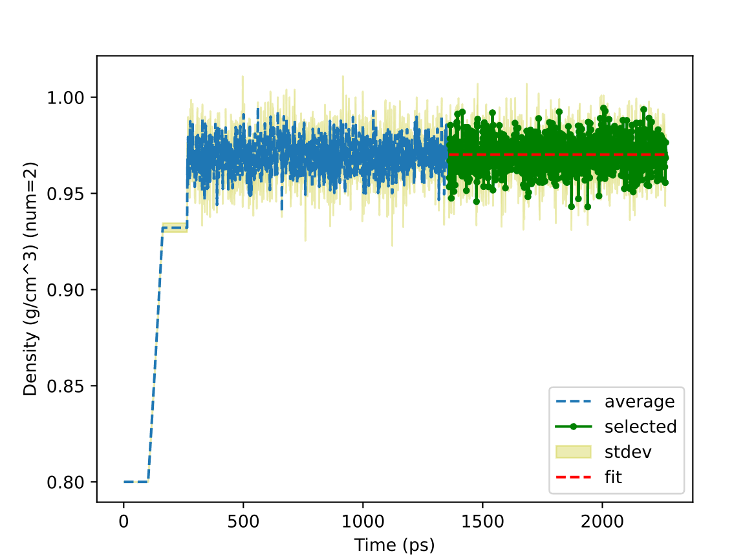
Scientific Test
https://macro.lsu.edu/HowTo/solvents/hexane.htm
https://www.vip-ltd.co.uk/Expansion/Density_Of_Water_Tables.pdf
07: Hexane Liquid Density
08: SPC Water Liquid Density
0.6372 vs 0.6548 g/cm³
(25 °C from ref)
0.9702 vs 0.9971 g/cm³
(25 °C, 1 atm from ref)
4 or 2 independent runs using different random seeds:
a) Amorphous builder at a density of 0.6548 g/cm³ or 0.8 g/cm³
b) Molecular dynamics (MTK at 300 K and 1 atm)
c) Density analysis
Notes:
To predict liquid phase density, we use MTK NPT ensemble.
Hexane and water predictions align with experimental measurements.
Though the SPC model underestimates the water density compared to the experiments,

Slide 22
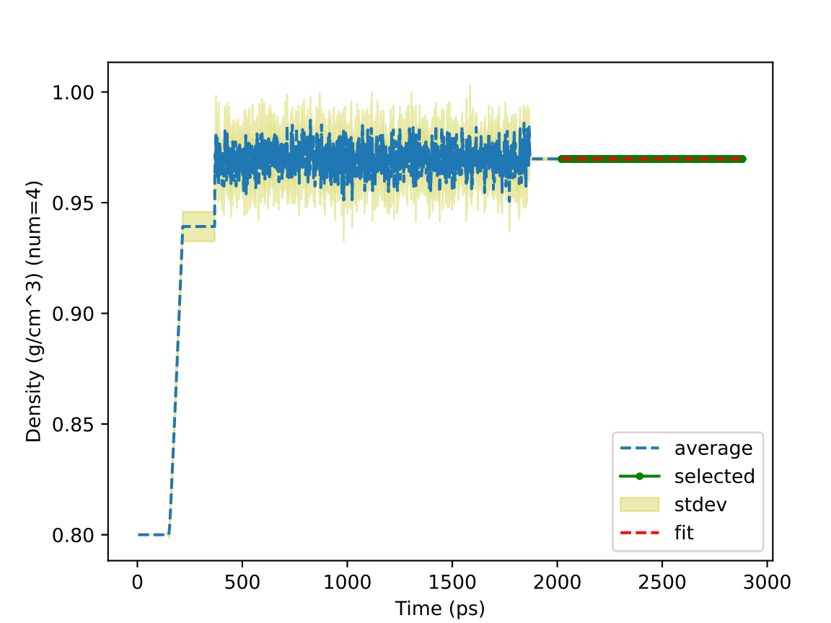
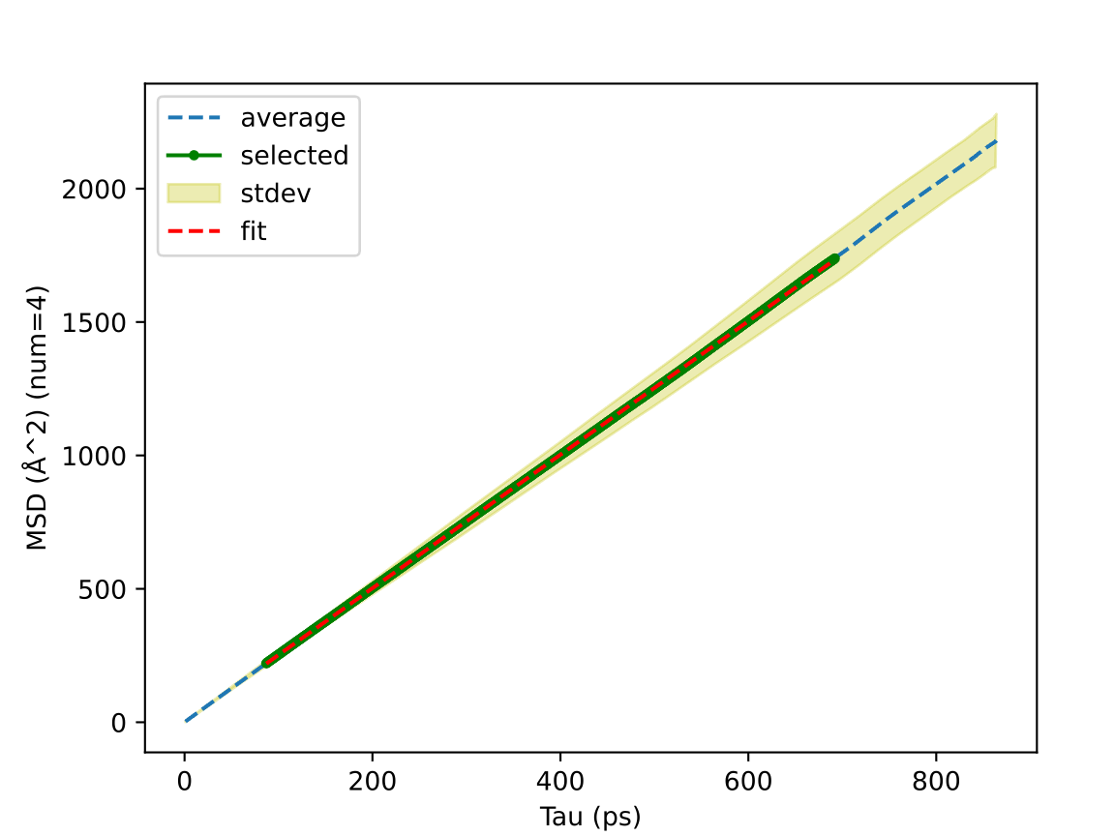
Scientific Test
J. Chem. Inf. Model. 2021, 61, 9, 4521–4536
09: SPC Water Liquid Density and Mean Squared Displacement
0.970 vs 0.972 g/cm³
(298.15 K, 1.0 atm)
f
d
e
g
c
a) NVT from low to target temp
b) Deform the box to match the press
c) NVT relaxation
d) NPT at target press and temp
e) Average the box
f) NVT relaxation
g) NVE production
b
Diffusion Coefficient
4.17e-05 vs 4.32e-05 cm²/s
(298.15 K, 1.0 atm from ref)
a
1 Seeded Amorphous Builder → Molecular Dynamics → Density and Mean Squared Displacement Analyses
2 …
3 …
4 …
Fit and Report
merge
Notes:
it matches the simulation reference perfectly.
Here, we used a robust relaxation protocol by changing the volume gradually. Basically, the simulation box is deformed to approach the target pressure.
The mean squared displacement shows linear behavior, and the diffusion coefficient matches the simulation reference.

Slide 23
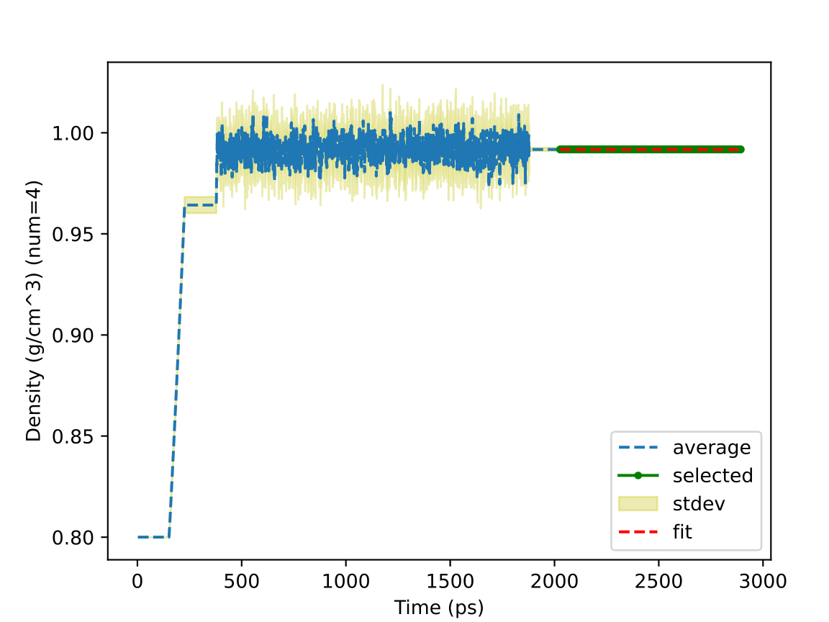
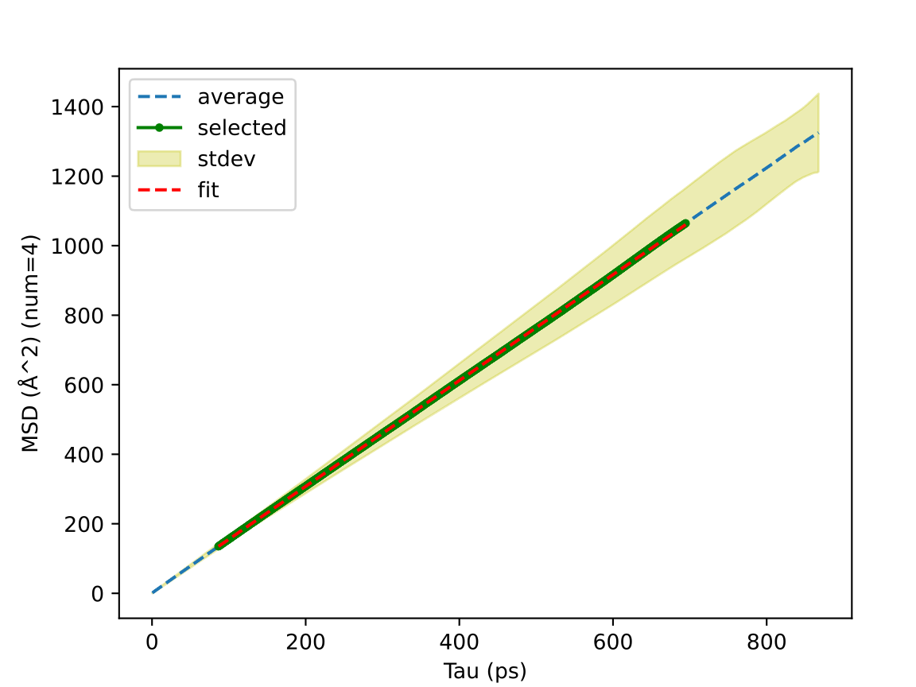
Scientific Test
J. Chem. Inf. Model. 2021, 61, 9, 4521–4536
https://www.vip-ltd.co.uk/Expansion/Density_Of_Water_Tables.pdf
https://dtrx.de/od/diff/
10: SPCE Water Liquid Density and Mean Squared Displacement
0.992 vs 0.993 g/cm³
(298.15 K, 1.0 atm from ref)
(expt 997.13 g/cm³ )
Diffusion Coefficient
2.54e-05 vs 2.60e-05 cm²/s
(298.15 K, 1.0 atm from ref)
(expt 2.317e-05 cm²/s)
1 Seeded Amorphous Builder → Molecular Dynamics → Density and Mean Squared Displacement Analyses
2 …
3 …
4 ...
Fit and Report
merge
Notes:
Compared to SPC, SPCE model predicts a higher density and lower diffusion coefficient.
These predictions are supported by simulation reference and match the experiments closely.

Slide 24
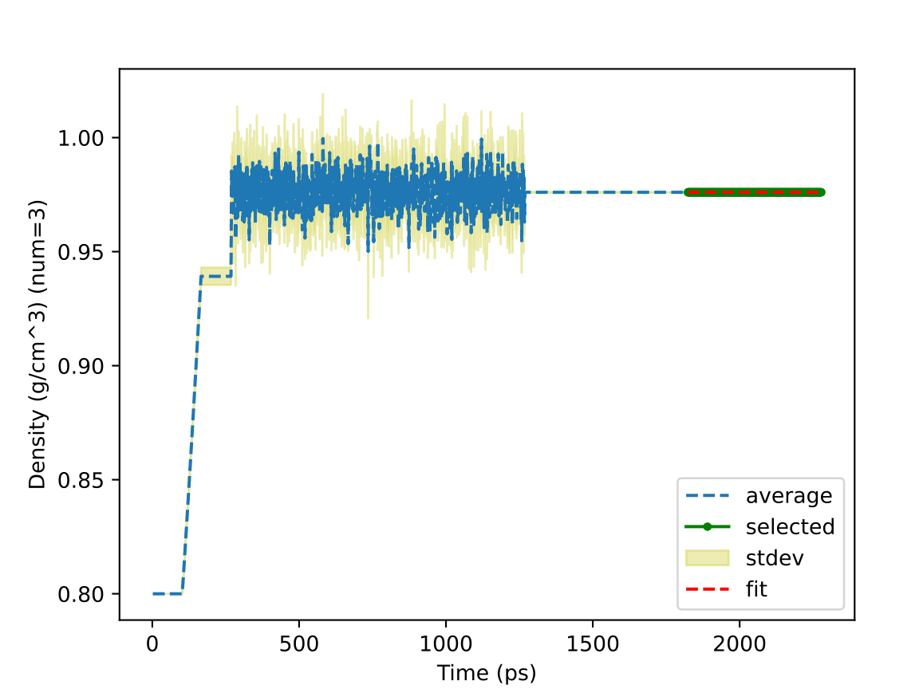
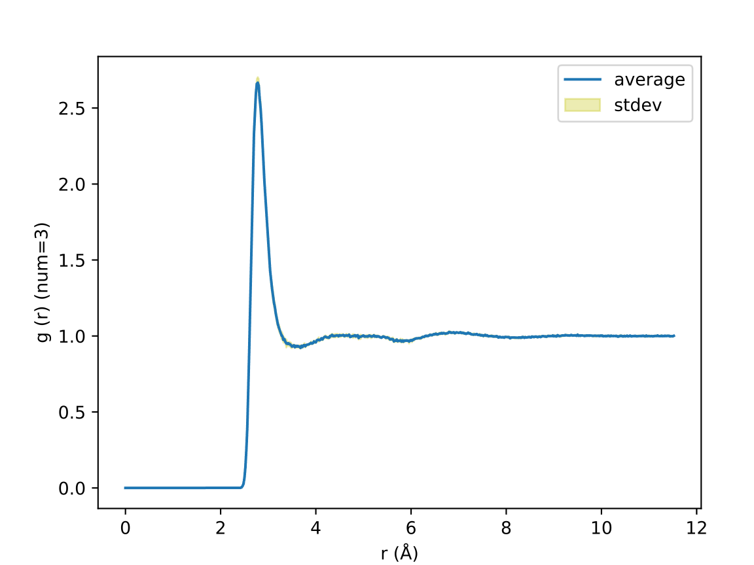
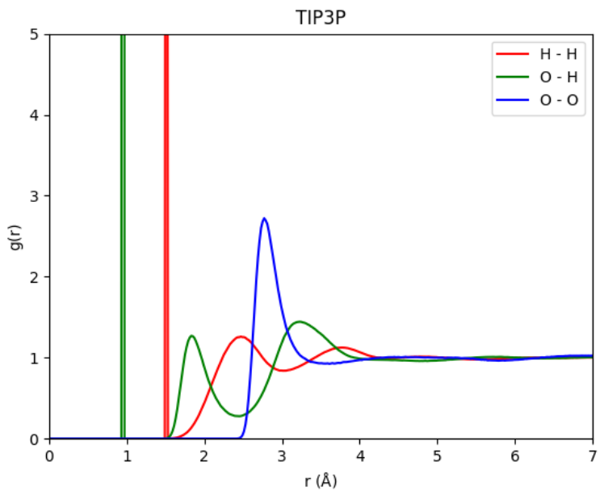
Scientific Test
J. Chem. Inf. Model. 2021, 61, 9, 4521–4536
11: TIP3P Water Liquid Density and Radial Distribution Function
from ref
0.976 vs 0.980 g/cm³
(298.15 K, 1.0 atm from ref)
1 Seeded Amorphous Builder → Molecular Dynamics → Density and Radial Distribution Function Analyses
2 …
3 …
Fit and Report
merge
Notes:
Another widely used water model is TIP3P.
We reproduced the density and radial distribution function in literature.

Slide 25
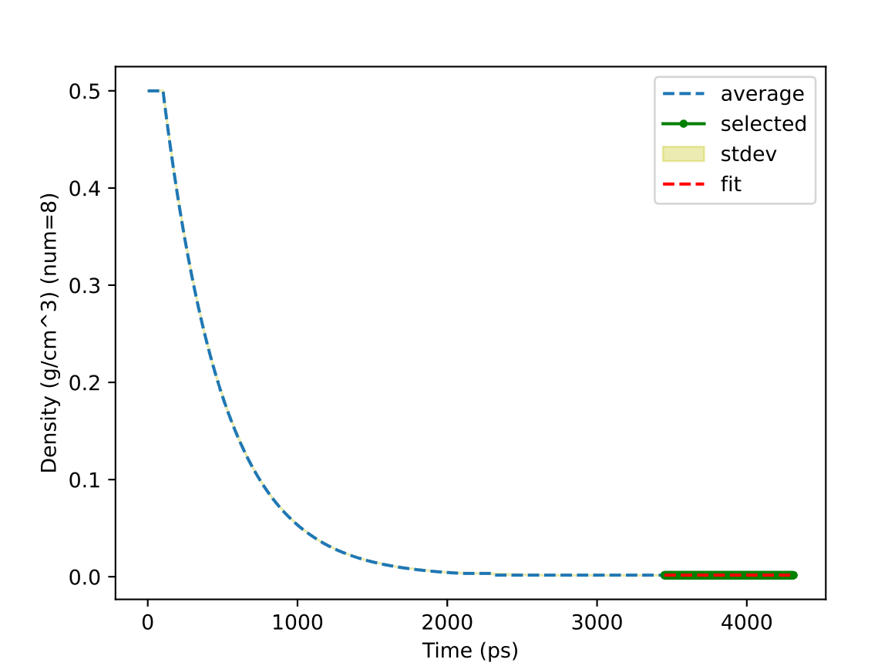
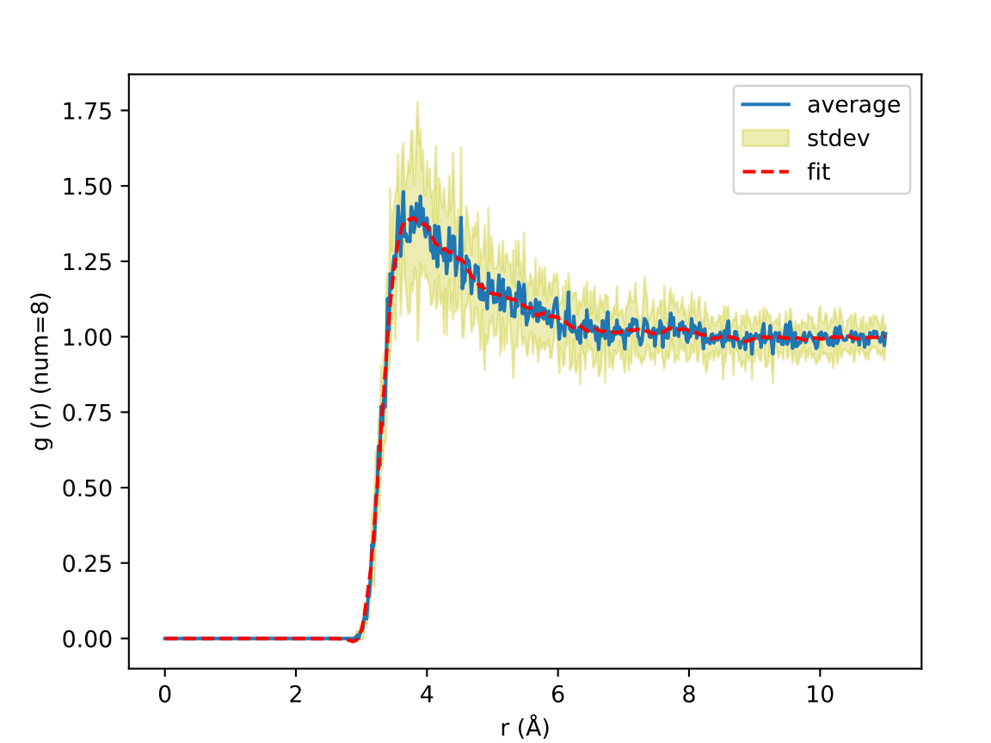
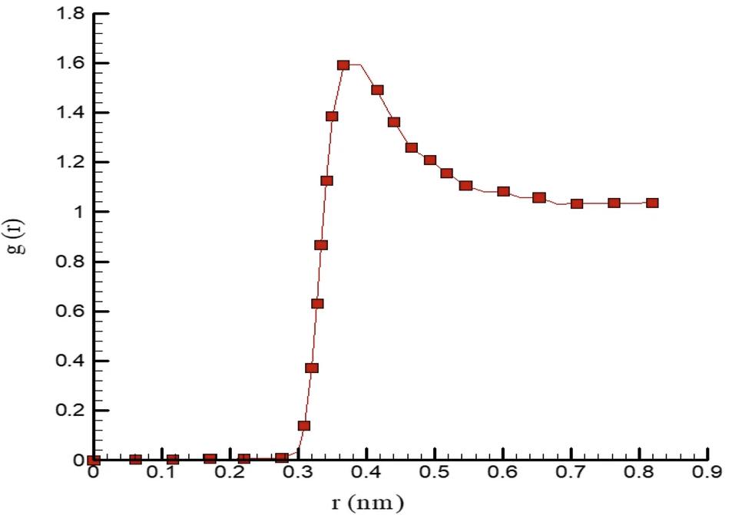
Scientific Test
https://www.engineeringtoolbox.com/argon-density-specific-weight-temperature-pressure-d_2089.html
Scientific Reports 2021 11:16912
12: Argon Gas Density and Radial Distribution Function
1.625 vs 1.603 kg/m³
(300 K, 1 bara from ref)
from ref
1 Seeded Amorphous Builder → Molecular Dynamics → Density and Radial Distribution Function Analyses
2 …
⋮
8 …
Fit and Report
merge
Notes:
Argon model is simple and robust.
The density prediction is accurate and radial distribution function is also reproduced.

Slide 26
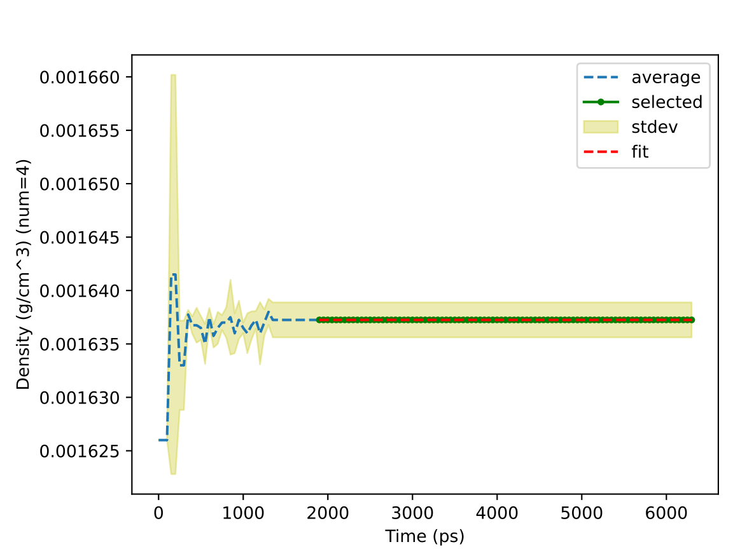
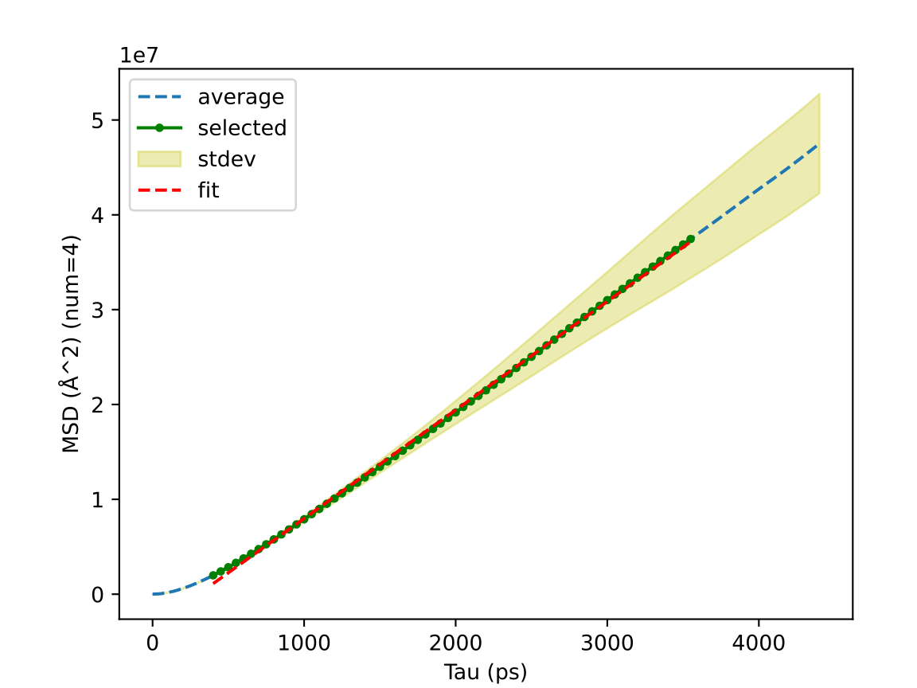
Scientific Test
https://www.engineeringtoolbox.com/argon-density-specific-weight-temperature-pressure-d_2089.html
https://doi.org/10.6028/NIST.TN.2279
13: Argon Gas Density and Mean Squared Displacement
1.637 vs 1.603 kg/m³
(300 K, 1 bara from ref)
Diffusion Coefficient
0.191 vs 0.182 cm²/s
(298 K, 1.0 atm from ref)
1 Seeded Amorphous Builder → Molecular Dynamics → Density and Mean Squared Displacement Analyses
2 …
3 …
4 …
Fit and Report
merge
Notes:
Mean squared displacement shows non-linear ballistic region below 1 nanosecond, and it also fluctuates wildly above 4 ns.
Diffusion coefficient is obtained by fitting the middle region, and our results match the experimental report nicely.

Slide 27
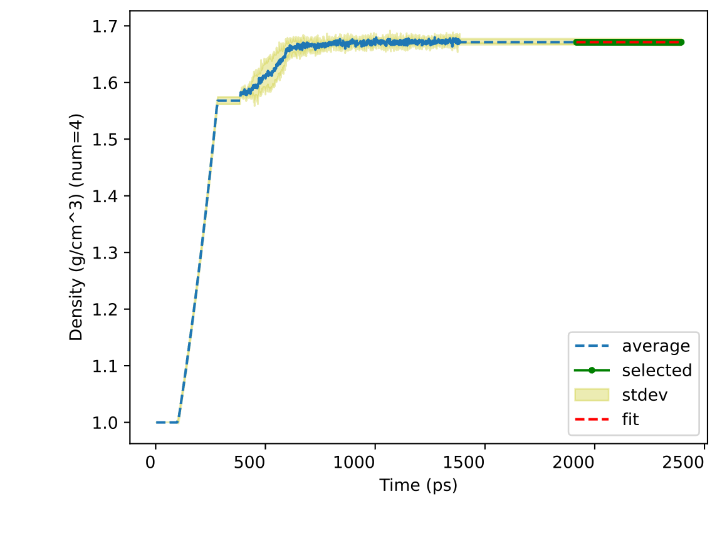
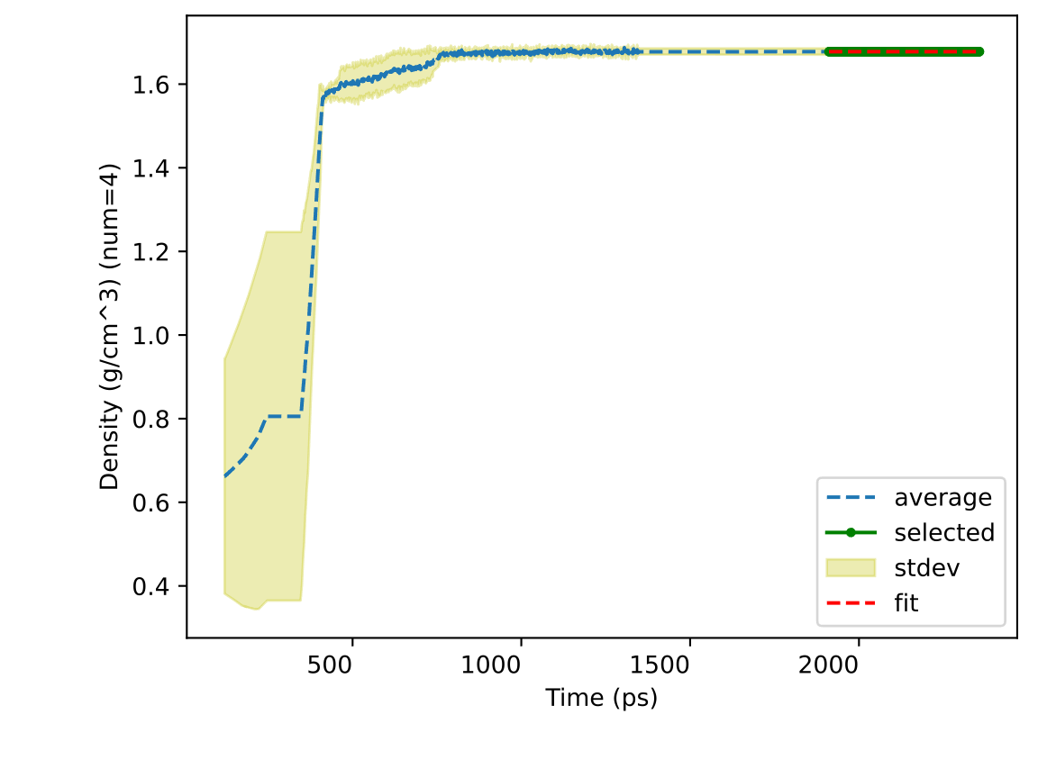
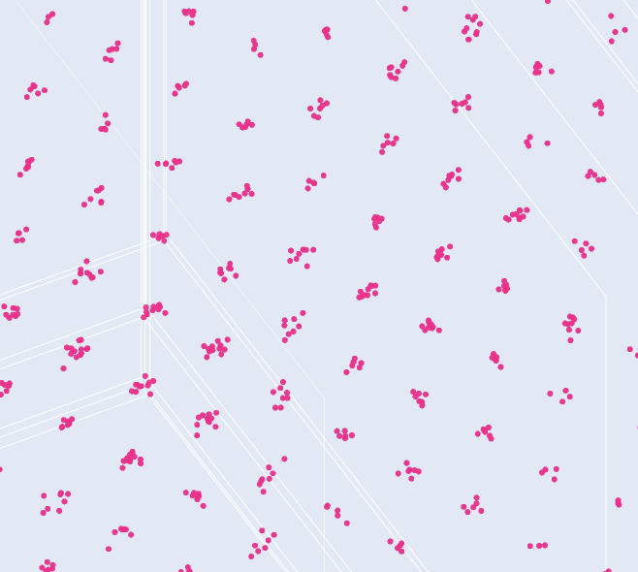
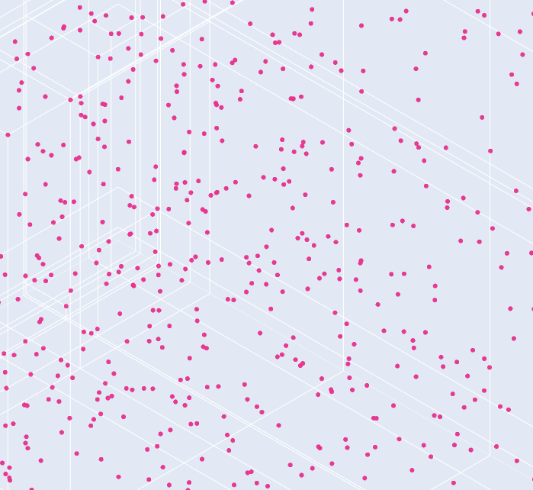
Scientific Test
Nature 1956, 178, 4531, 483-483
17 & 18: Argon Solid Density at 50K from Different Initial Densities
1.671 vs 1.691 g/cm³
(60 K from ref)
1.678 vs 1.691 g/cm³
(60 K from ref)
crystal
amorphous
1 Seeded Amorphous Builder → Molecular Dynamics → Density Analyses
2 …
3 …
4 …
Fit and Report
merge
Notes:
Interestingly, amorphous initial structures spontaneously form crystals at low temperature.
The crystal density can be predicted even if the initial density are quite differnet.

Slide 28
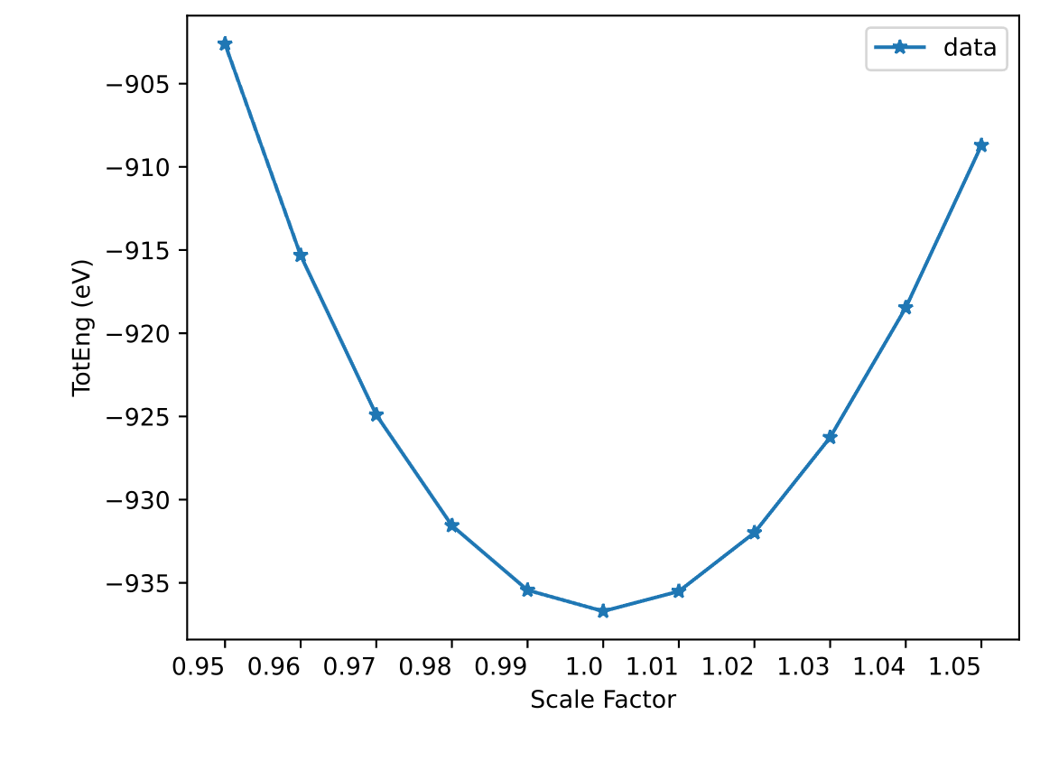
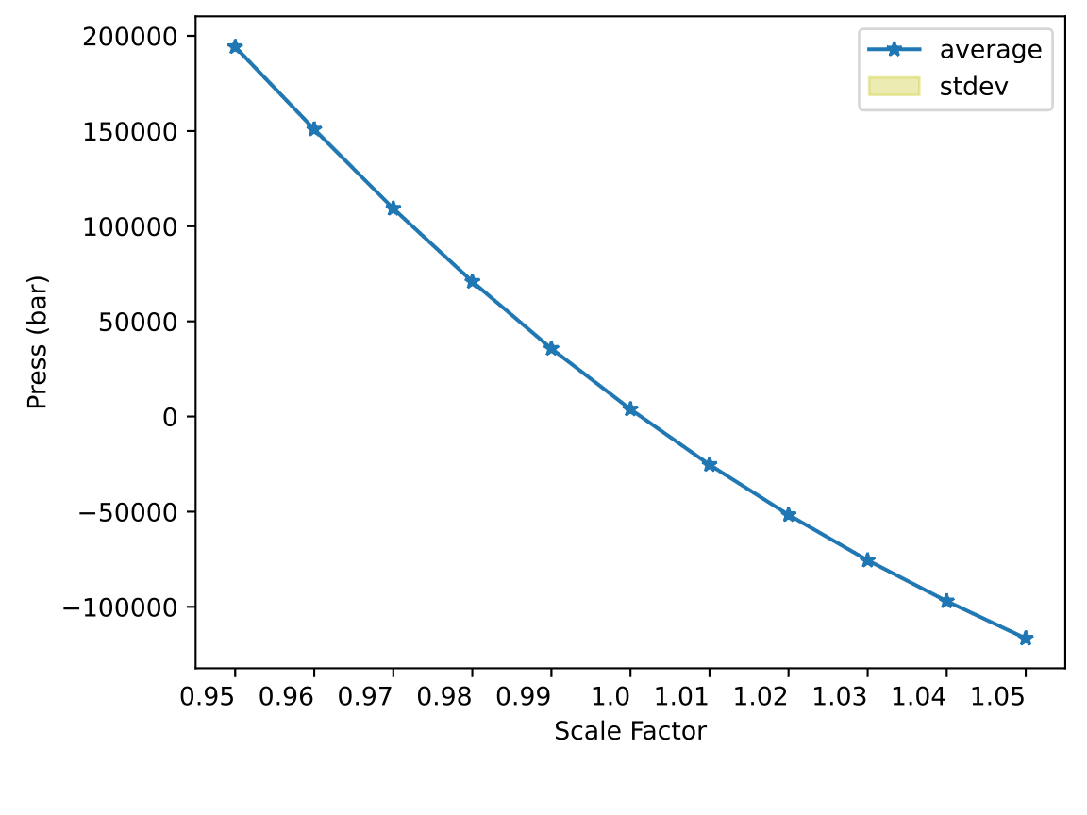
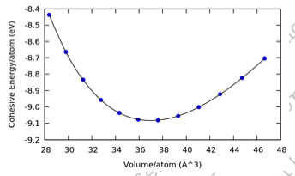
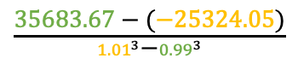
Scientific Test
https://www.paradim.org/sites/default/files/2019-05/Equilibrium_Structure_of_a_Diatomic_Molecule_and_a_Bulk_Crystal.pdf
https://www.shalomeo.com/Si-Silicon.html
14: Silicon Total Energy at 0K
15: Silicon Pressure at 300K
from ref
Bulk Modulus
101.68 vs 102 GPa from ref
$\frac{\text{35683.67}\text{ − }\text{(}\text{−25324.05}\text{)}}{{1.01}^{3}\text{−}{0.99}^{3}}$
Crystal Builder with Scaled Lattice (0.95) → Molecular Dynamics → Total Energy / Pressure Analysis
… (0.96) …
⋮
… (1.05) …
Fit and Report
merge
Notes:
The silicon unit cell is scaled with different factors and then replicated to create the supercell.
Single point energy is calculated using Stillinger-Weber potential.
Compression is found to take more energy than expansion.
The bulk modulus is calculated as pressure over volume from NVT ensembles.
The prediction is pretty accurate compared to experimental measurements.

Slide 29
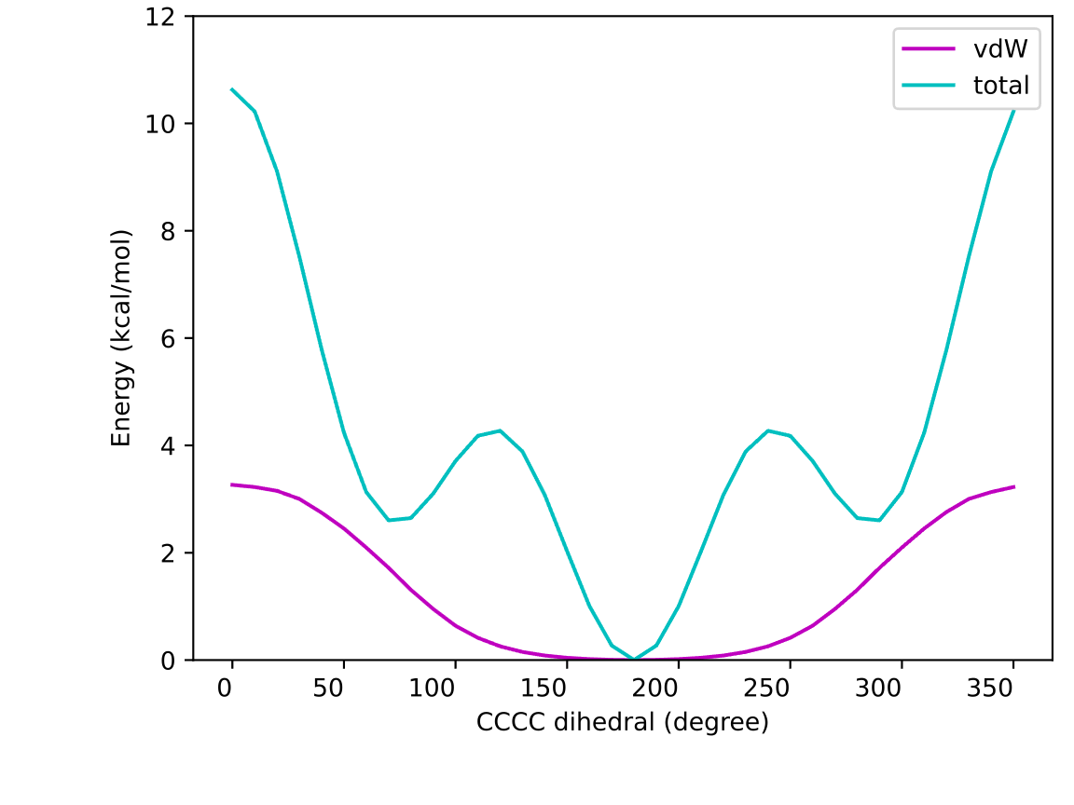
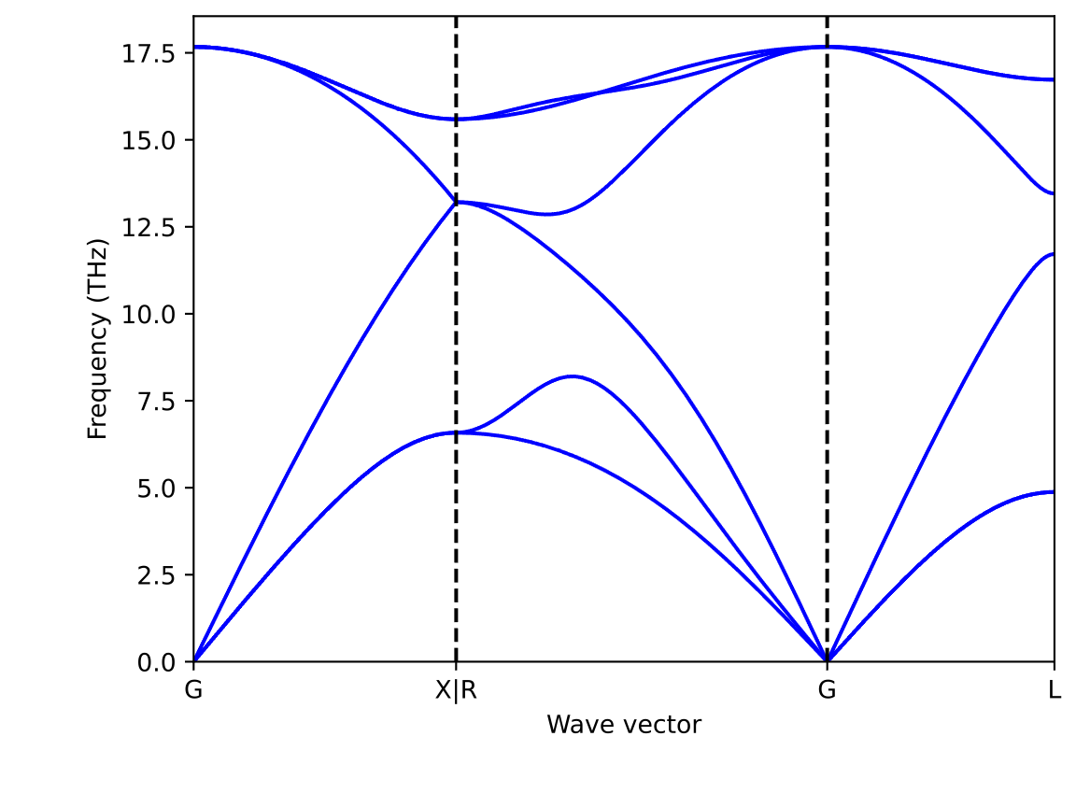
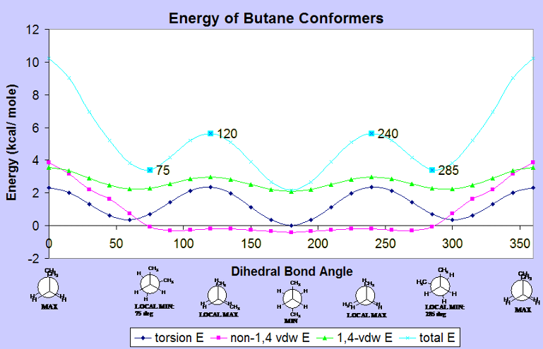
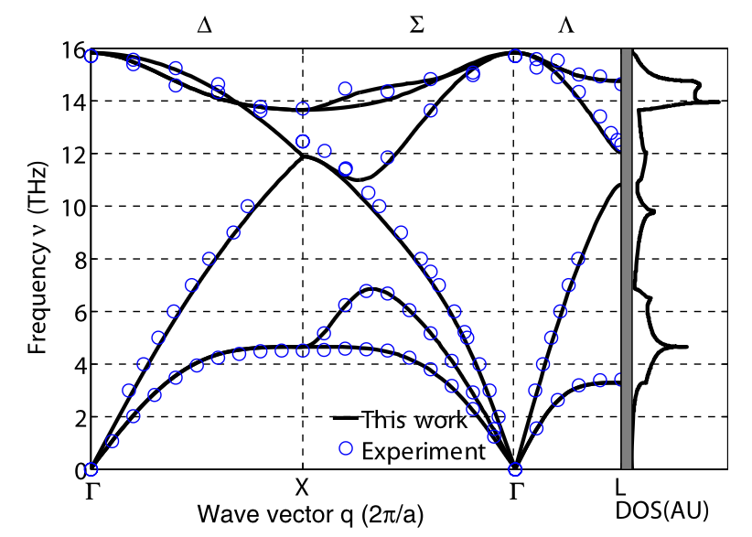
Scientific Test
https://www.sas.upenn.edu/~kimg/mcephome/chem502/ethbutconform/butane.htm
J. Phys.: Condens. Matter 20 (2008) 145213
16: Butane Torsion Energy Hypersurface
Integration 44 : Silicon Phonon Dispersion
11 vs 8 kcal/mol from ref
from ref
Molecule Builder (0) → Molecular Dynamics → Total / Pair Energy
… (10) …
⋮
… (360) …
symmetry
primitive cell
kpoint
displacement
crystal
phonon
data file
unit cell
super cell
xyz
force
force constant
Notes:
We also build butane conformers and plot torsion energy hypersurface.
Though OPLS-UA model reproduces the general landscape, the internal torsion energy is overestimated.
Unlike the decentralized automation, phonon dispersion calculation centers around crystal.
We build a supercell to calculate forces due to atomic displacement.
The input coordinates are further optimized so that the atoms vibrate around equilibrium positions.
Phonon frequencies are calculated at different reciprocal points.
Symmetry reduces the displacement number and simplifies the kpoint path.
We reproduce the silicon phonon dispersion in literature.

Slide 30
Roadmap
Jobcontrol
Signac dependency drop
Running subjob monitor
Job scheduler submission (e.g, slurm)
CPU and GPU resource allocation
Force Field
LAMMPS distributed potentials:
Many-body potentials (e.g., EAM, MEAM, Tersoff)
reactive force field (e.g., REBO, AIREBO, COMB, ReaxFF)
Conventional & machine learning interatomic potentials (OpenKIM)
Coarse-grained (e.g. MARTINI)
Classic all-atom force field (e.g, OPLS)
Structure Generation: supported structures
DFT Calculation: accuracy vs cost
Force Constant Fit: Energy + Formula → Parameters
Typer: Type the atoms by atoms, bonding, and neighbors
Assignment: assign parameters based on the matches
Density Functional Theory
DFT deployment
Builder and analyzer
Lattice Dynamics
Force from DFT calculation
Lattice thermal conductivity
Density of states
Low dimensional materials
K-path finder and visualizer (e.g., SeeK-path)
Application
Structure: Reader subclasses Struct
Polymer: branching, ladder, faster grow
Crystal: build from space group, larger database
Property: dielectric constant, viscosity, elastic constant, solubility, and thermal conductivity
Notes:
Above is what we have right now, and we are always ambitious about the future.
Jobcontrol will undergo a major change to include job monitor, scheduler submission, and resource allocation.
We can automate additional many body potentials distributed by LAMMPS or parametrized our own.
How about the machine learning potentials and coarse-grained model?
We may also develop OPLS-AA force field or extend the existing united one.
Both force field parametrization and lattice dynamics calculation request DFT deployment and automation.
We may cover thermal conductivity, density of states, and low dimensional materials.
Last but not the least, we should extend our application focused features.
For example, the reader classes should subclass the writer ones. Polymer supports branching, ladder, and faster grow method.
We should support more properties such as dielectric constant, viscosity, elastic constant, solubility, and thermal conductivity.

Slide 31
Conclusion
Simple and Fast Installation: 9 min on a new machine by two clicks
Predictable Development Environment: POSIX, DEBUG, CPU, etc.
Well-Designed Architecture: 239 classes, 12 standalone functions
100% coverage Unit Tests: 1937 in 40s
Fast Amorphous Builder: 100 million Ar (20 min), 20,000 (−CH₂−)₁₀₀ (22h, 0.5 g/cm³ )
Efficient Trajectory Analysis*: density (2 sec), RDF (6 min), MSD (3 min), 200 MB memory
Robust Relaxation Protocol: methane (gas), water (liquid), and argon (solid)
Various Properties: diffusion coefficient, energy hypersurface, phonon dispersion, etc.
Thank you!
*25,000 frames x 600 atoms
Notes:
To summarize:
We provide: simple and fast installation -- 9 min on a brand new machine by 2 clicks
Predictable Development Environment: standard POSIX syntax, consistent debug experience, smart resource allocation.
Well-Designed Architecture: 239 classes vs only 12 standalone functions.
100% Coverage: 1937 unit tests in 40s
Fast Amorphous Builder: 20 min for 100 million Ar atoms; 20h for 20,000 polyethylene chains at 0.5 g/cm³
Efficient Trajectory Analysis: 2s for density, 6 min for RDF, 3 min for MSD, and only 200 MB memory
Robust Relaxation Protocol for gas, liquid, and solid.
Various Properties: diffusion coefficient, energy hypersurface, and phonon dispersion.
Thank you for all your attendance, and I am ready for questions.

Slide 32
Command-Line Arguments
Script Flag | Description | Comment
-seed SEED | Set random state | Randomize coordinate, velocity, sequence, selection, etc.
-JOBNAME JOBNAME | Name output files | Jobname[_type].{log, csv, data, npz, parquet, etc.}
-INTERACTIVE | Pause for user input | Zoom in / out figure, set initial guess, etc.
-PYTHON {-1,0,1,2} | 0: native; 1: compiled; 2: cached | High performance compiled python.
-CPU INT [INT ...] | Total number of CPUs [num for one task] | Limit the total resource and max single consumption
-DEBUG | Additional printing and output files | Surfaces the issues instead of prioritizing performance
Workflow Flag | Description | Comment
-jtype {task,aggregator} | Task: run calculations and register files Aggregator: collect results | High-cost tasks and light-weight aggregators can run either serially or separately.
-clean | Clean previous results | Run on top of previous results or from scratches
-screen {off,serial,parallel,job} | Screen status: off, serial, parallel, and job details | Run batch script silently or with selected printing
-DEBUG [{True,False}] | Additional printing and output files | Set the (sub)jobs the debug mode
export SHALLOW=1 increases the performance at the sacrifice of stability. (e.g. shallow copy, unclean build)

Slide 33
Environmental Configuration
source premake sets the environment in which source code instead of installation is used.
# /bin/sh : ' Set up the environment for the module, sh, driver, workflow, and submodule directories. Usage: . premake source premake ‘
# Shell Type and Root Directory if [ $(basename $0) = 'premake' ] then NEMD_SRC="$0" && echo "zsh" elif [ $BASH_SOURCE ] then NEMD_SRC=${BASH_SOURCE[0]} && echo "POSIX" else x="$(lsof -p $$ -Fn0 | tail -1 | tr -d "\0")" && NEMD_SRC=${x#*n} && echo "dash" fi [ ! -f $NEMD_SRC ] && echo "Cannot locate the source root" && return NEMD_SRC="$(readlink -f ${NEMD_SRC} | xargs dirname)" && echo $NEMD_SRC
# Searchable Module: NEMD add_pypath() { [ -d "$1" ] && echo $PYTHONPATH | grep -q "$1" && return export PYTHONPATH="$1${PYTHONPATH:+":$PYTHONPATH"}" } add_pypath $NEMD_SRC/module
# Searchable Script: Shell, Workflow, Driver, and Submodule path() {
[ -d "$1" ] && echo $PATH | grep -q "$1” || export PATH="$1${PATH:+":$PATH"}”
} add_path $NEMD_SRC/sh add_path $NEMD_SRC/driver add_path $NEMD_SRC/workflow add_path $NEMD_SRC/module/alamode/alamode/tools
Notes:
premake sets the environment in which source code instead of installation is used.
The root directory is set as NEMD_SRC, based on which any data or scripts can be located.
Module is importable by setting the PYTHONPATH.
Scripts are searchable by adding to the system PATH.

Slide 34
setup.py
class Darwin: """ macOS installer. """ def prereq(self, *pkgs): """ Install the packages required by compilation. """ if not self.lmp_exe: pkgs += self.LMP_PKGS cmd = ' '.join(self.INSTALL + pkgs) subprocess.run(f"echo {cmd}; {cmd}", shell=True) def compile(self): """ Compile the binaries. """ subprocess.run('bash install.sh', shell=True)
class Linux(Darwin): """ Linux installer. """ def prereq(self, *pkgs): """ Customize the prerequisites for Linux machine. """ info = subprocess.run('nvidia-smi | grep NVIDIA') if not info.returncode: pkgs += ('nvidia-cuda-toolkit’, ) super().prereq(*pkgs)
Installer = {'darwin': Darwin, 'linux': Linux}[sys.platform] class Distribution(Installer): """ Distribute the scripts, packages and data. """ def run(self): """ Main method to install and distribute. """ self.prereq()
self.compile() self.setup()
python3.10 setup.py install --verbose
Function | setuptools.setup
Module | packages = [nemd, alamode]
Python files | package_dir = {nemd: module/nemd}
Non-python | package_data= {lammps: [build/lmp]},
Scripts | scripts=[sh/nemd_run]
packages | install_requires=[numpy, scipy]
Metadata | classifiers=[Status :: Production/Stable]
site-packages/
bin/

